Slide 1



Slide 2
When are the SATs?
The SATs take place over four days, starting on Monday 11th May ending on Thursday 14th May.
The SATs papers consist of:
Grammar, punctuation and spelling (paper 1: GPS) – Monday 11th May
○ Grammar, punctuation and spelling (paper 2: Spelling) – Monday 11th May
○ Reading – Tuesday 12th May
○ Maths (paper 1: Arithmetic) – Wednesday 13th May
○ Maths (paper 2: Reasoning) – Wednesday 13th May
○ Maths (paper 3: Reasoning) – Thursday 14th May
Writing is assessed using evidence collected throughout Year 6. There is no Year 6 SATs writing test.

Slide 3
When and how the SATs are completed
The tests take place during normal school hours, under exam conditions.
After the tests are completed, the papers are sent away to be marked externally.
The results are then sent to the school in July.
Each test lasts no longer than 60 minutes:
Spelling, punctuation and grammar (paper 1: Grammar/ Punctuation) – 45 minutes
Spelling, punctuation and grammar (paper 2: Spelling) – 15 minutes
Reading – 60 minutes
Maths (paper 1: Arithmetic) – 30 minutes
Maths (paper 2: Reasoning) – 40 minutes
Maths (paper 3: Reasoning) – 40 minutes

Slide 4
Specific arrangements for SATs
Children with additional needs (who have similar support as part of day-to-day learning in school) may be allotted specific arrangements, including:
Additional (extra) time;
Tests being opened early to be modified;
An adult to scribe (write) for them;
Using word processors independently;
An adult to read for them;
The use of prompts or rest breaks;
Arrangements for children who are ill or injured at the time of the tests.
Pupils with an EHCP are automatically allowed up to 25% additional time (except for the spelling paper, which is not strictly timed).

Slide 5
The results
Tests are marked externally. Once marked, the tests will be given the following scores:
A raw score (total number of marks achieved for each paper);
A scaled score (see below);
A judgement on if the National Standard has been met.
After marking each test, the external marker will convert the raw score to a scaled score. Even though the tests are made to the same standard each year, the questions must be different. This means the difficulty of the tests may vary. Scaled scores ensures an accurate comparison of performance over time.
Scaled scores range from 80 to 120.
A scaled score of 100 or more shows the pupil is meeting the National Standard.

Slide 6
Grammar, Punctuation and Spelling
Grammar, Punctuation and Spelling: Monday 11th May Grammar, punctuation and spelling consists of two papers.
Paper 1 focuses on all three elements (grammar, punctuation and spelling or GPS). The paper lasts for 45 minutes.
Paper 2 consists of a spelling test only. It should take approximately 15 minutes, although this is not a set amount of time (pupils should be given as much time as they need to complete the test).

Slide 7
Grammar, Punctuation and Spelling: Paper 1 (GPS)
The children will have been working hard with their class teacher on developing and securing their knowledge of the technical vocabulary needed in this test.
This test focuses on:
Grammatical terms/ word classes;
Functions of sentences;
Combining words, phrases and clauses;
Verb forms, tenses and consistency;
Punctuation;
Vocabulary;
Standard English and formality.
This test requires a range of answer types, but does not require longer formal answers.

Slide 8
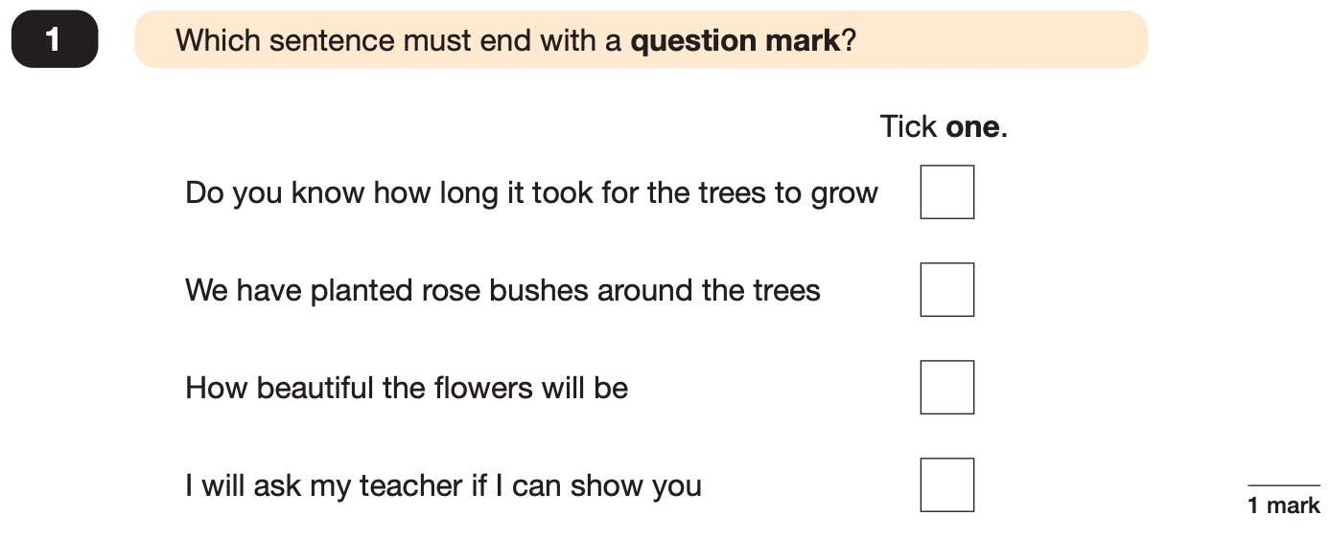
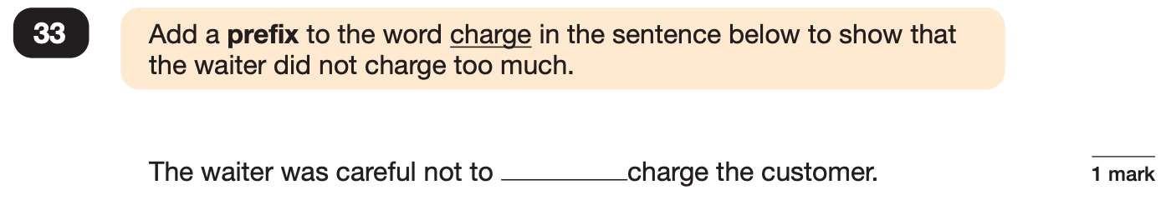
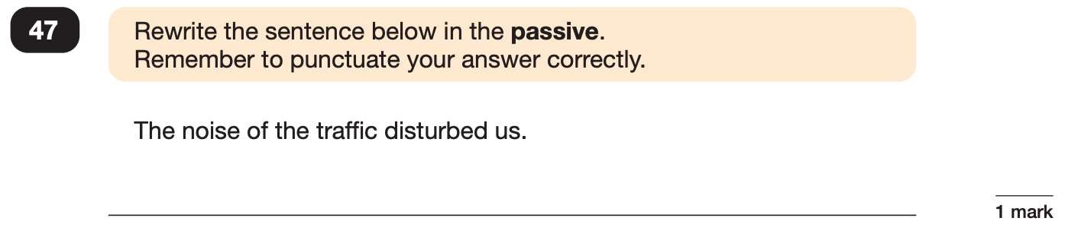
Grammar, Punctuation and Spelling: Paper 1 Example
✓
over
e.g. We were disturbed by the noise of the traffic.

Slide 9
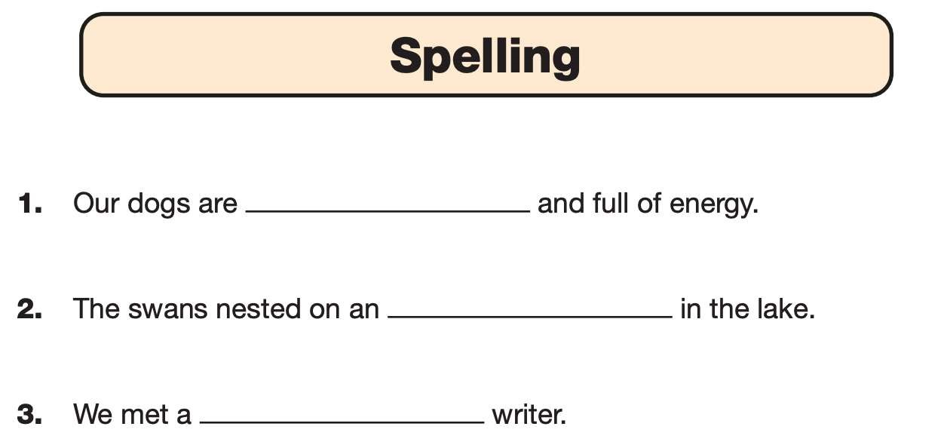
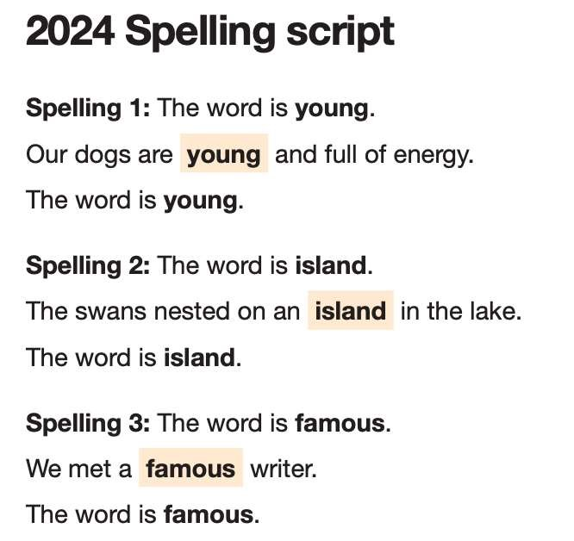
Grammar, Punctuation and Spelling: Paper 2 (spelling)
Paper 2 is a shorter paper that focuses solely on spellings.
Example questions:

Slide 10
Reading: Tuesday 12th May
There is one reading test that lasts for 60 minutes.
There are three different set texts for children to read.
These could be any combination of non-fiction, fiction and/ or poetry.
The test covers the following areas:
Give/ explain the meaning of words in context;
Retrieve and record information/ identify key details from fiction and non-fiction;
Summarise main ideas from more than one paragraph;
Make inferences from the text/ explain and justify inferences with evidence from the text;
Predict what might happen from details stated and implied;
Identify/ explain how information is related and contributes to meaning as a whole;
Identify/ explain how meaning is enhanced through choice of words and phrases;
Make comparisons within the text.

Slide 11
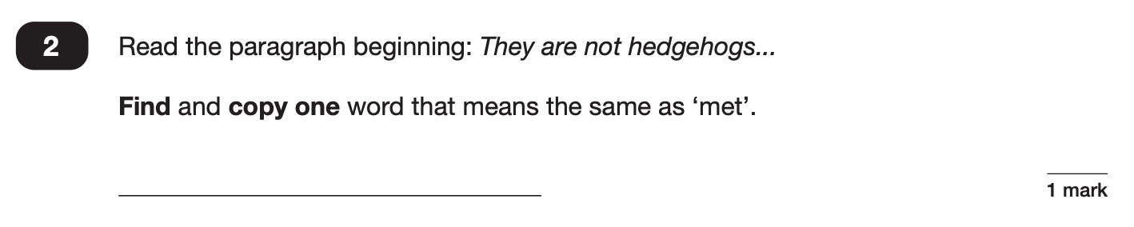

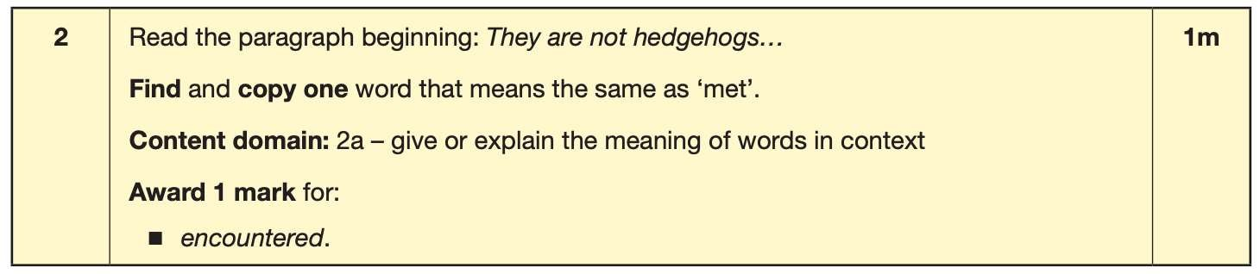
Reading
The reading SATs paper requires a range of answer styles.
Example questions:

Slide 12
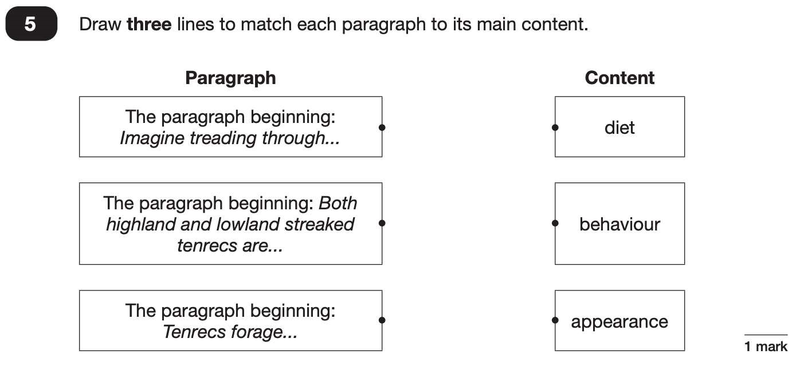
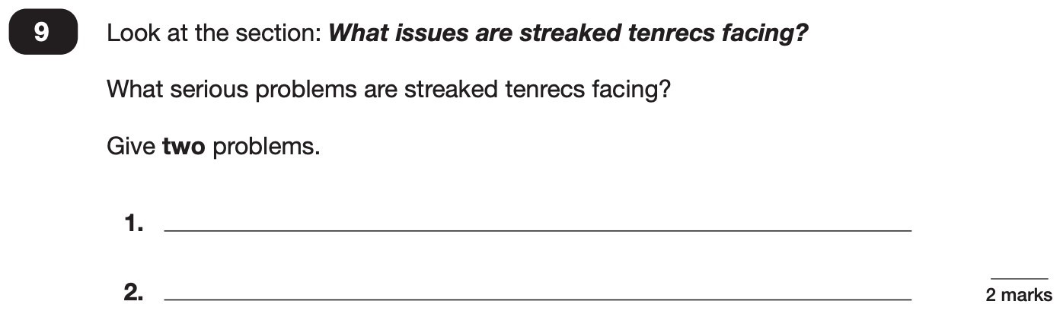
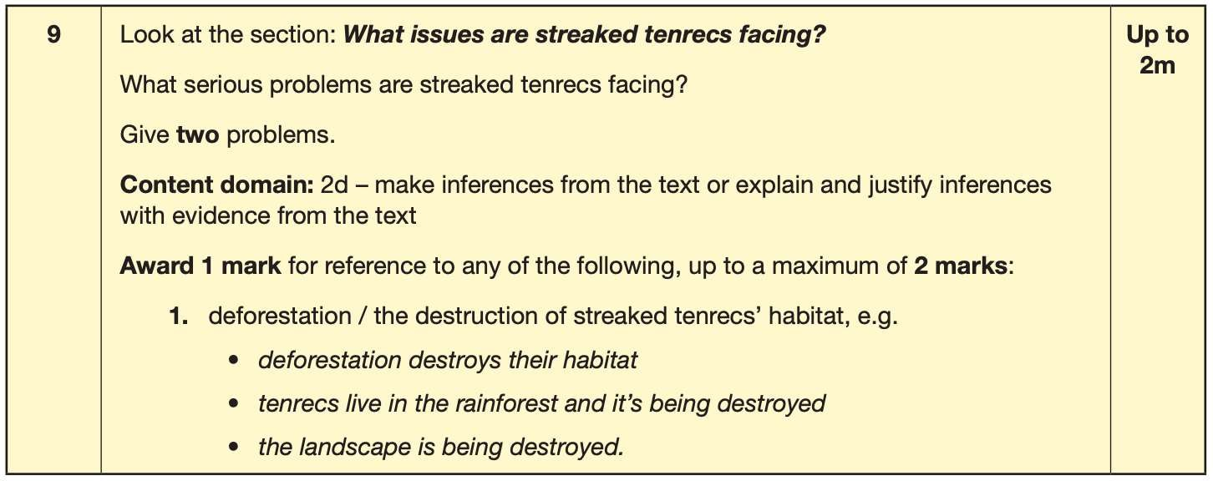
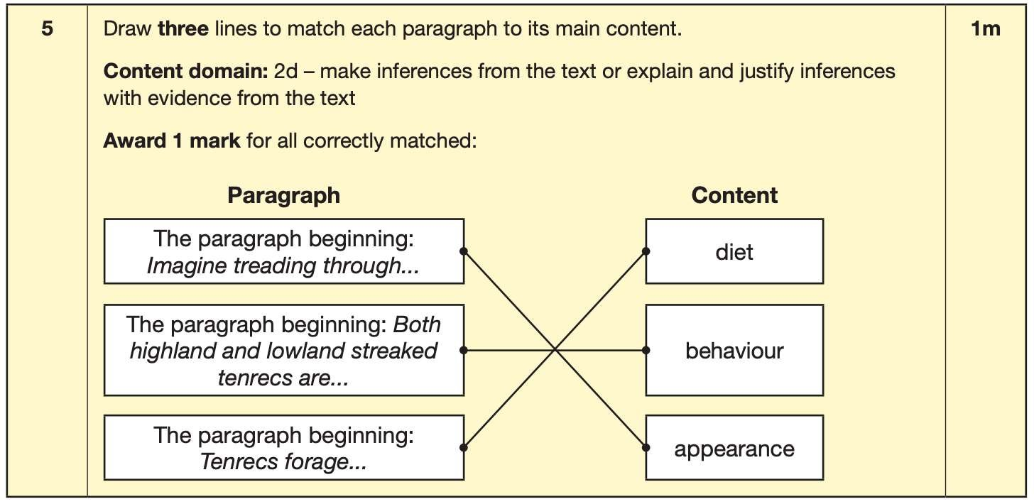

Slide 13
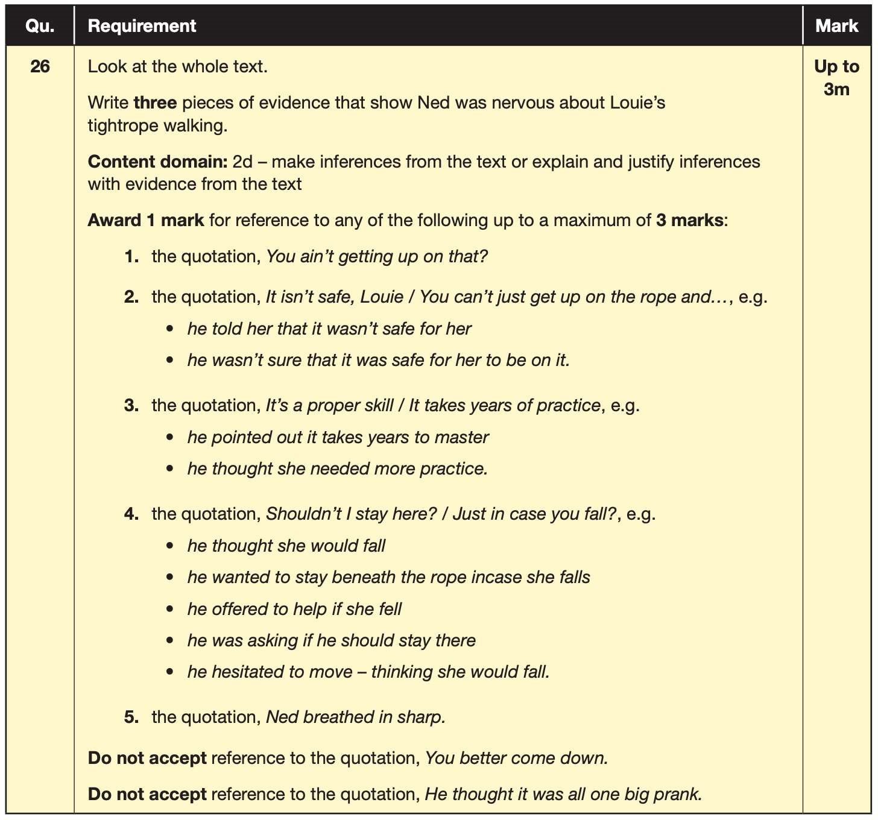
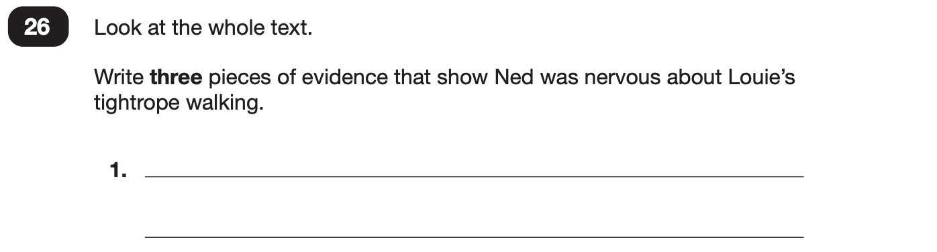
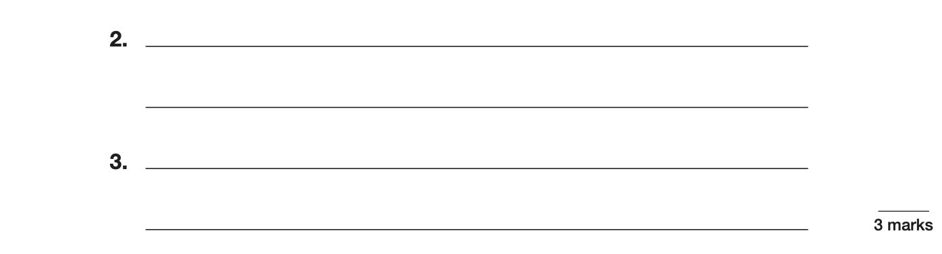

Slide 14
Since the current testing formation for the SATs began in 2016, there has been a tendency for three types of questions to be the most popular.
For example, in the 2024 Reading SATs paper:
10% of marks could be gained from answering questions involving giving and explaining the meaning of words in context;
38% of marks could be gained from answering questions involving retrieving and recording information or identifying key details from a text;
44% of marks could be gained from answering questions involving making inferences from a text and justifying inferences with text evidence.

Slide 15
How you can help at home
When reading with your child at home try focusing on these types of questions.
Example questions to ask at home:
What does this word mean?
Which word in this paragraph is the closest in meaning to…?
What [character] doing when [event] happened?
True or false questions about a paragraph/ text.
Why do you [character] did [event]? Can you think of another reason?

Slide 16
Maths: Wednesday 13th May and Thursday 14th May
The maths assessments consist of three tests.
Paper 1: Arithmetic (30 minutes) – Wednesday 13th May
Paper 2: Reasoning (40 minutes) – Wednesday 13th May
Paper 3: Reasoning (40 minutes) – Thursday 14th May

Slide 17
Arithmetic Test
The maths arithmetic paper has a total of 40 marks and lasts for 30 minutes.
The test covers the four operations (addition, subtraction, multiplication, division, including order of operations requiring BIDMAS), percentages of amounts and calculating with decimals and fractions.

Slide 18
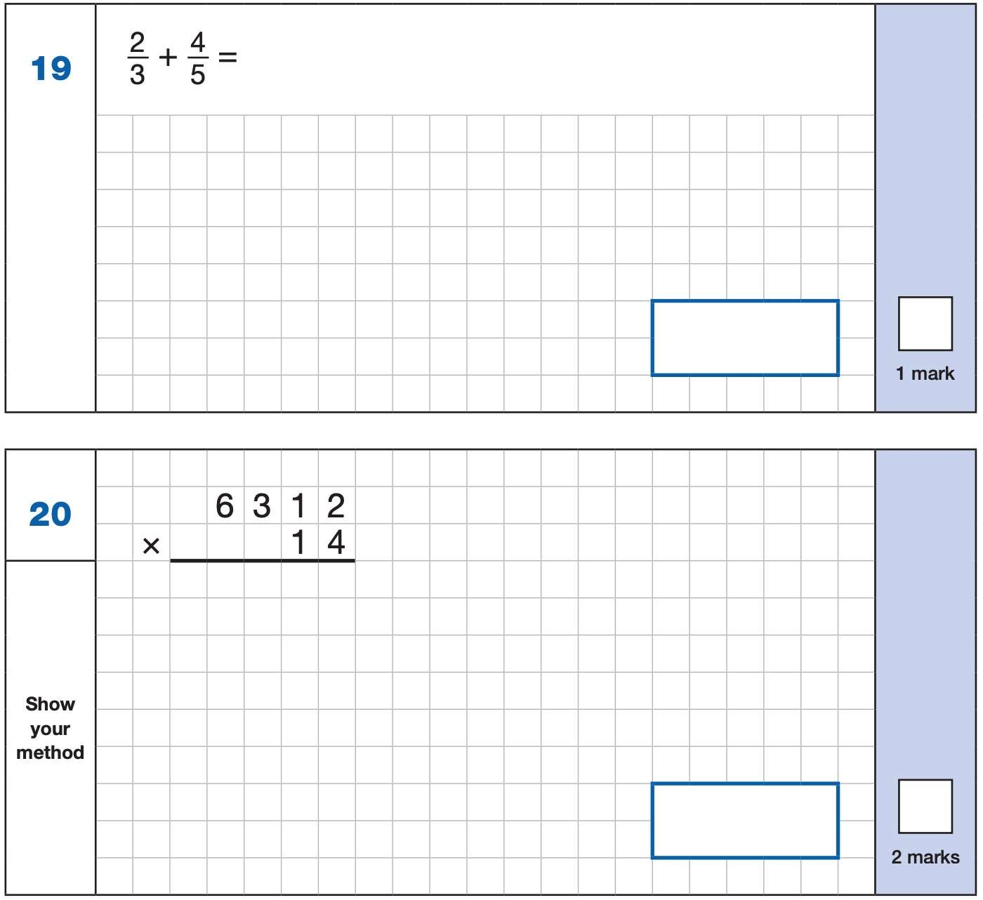
The test is usually 36 questions,
with four of them worth 2 marks
each (two long multiplication and
Two long division).
We are currently undertaking an
arithmetic test weekly so pupils
get used to the questions and
methods to solve them.

Slide 19
Maths Papers 2 and 3 (Reasoning)
These tests have a total of 35 marks each and lasts for 40 minutes each.
These papers require children to demonstrate their mathematical knowledge and skills, as well as their ability to solve problems and their mathematical reasoning. They cover a wide range of mathematical topics from key stage 2 including:
Number and place value (including Roman numerals);
The four operations;
Geometry (properties of shape, position and direction);
Statistics;
Measurement (length, perimeter, mass, volume, time, money);
Algebra;
Ratio and proportion;
Fractions, decimals and percentages.

Slide 20
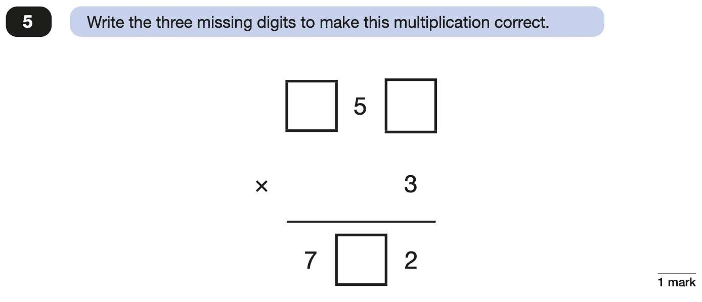
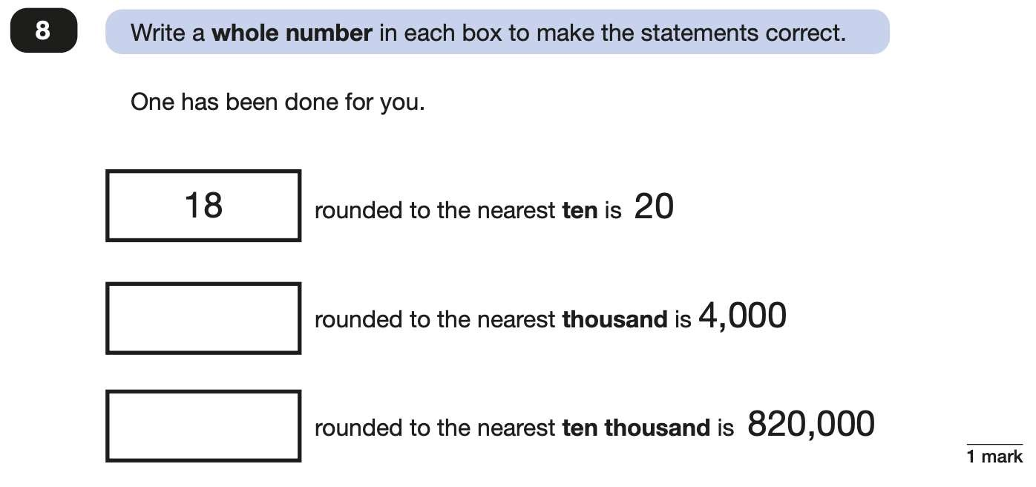

Slide 21
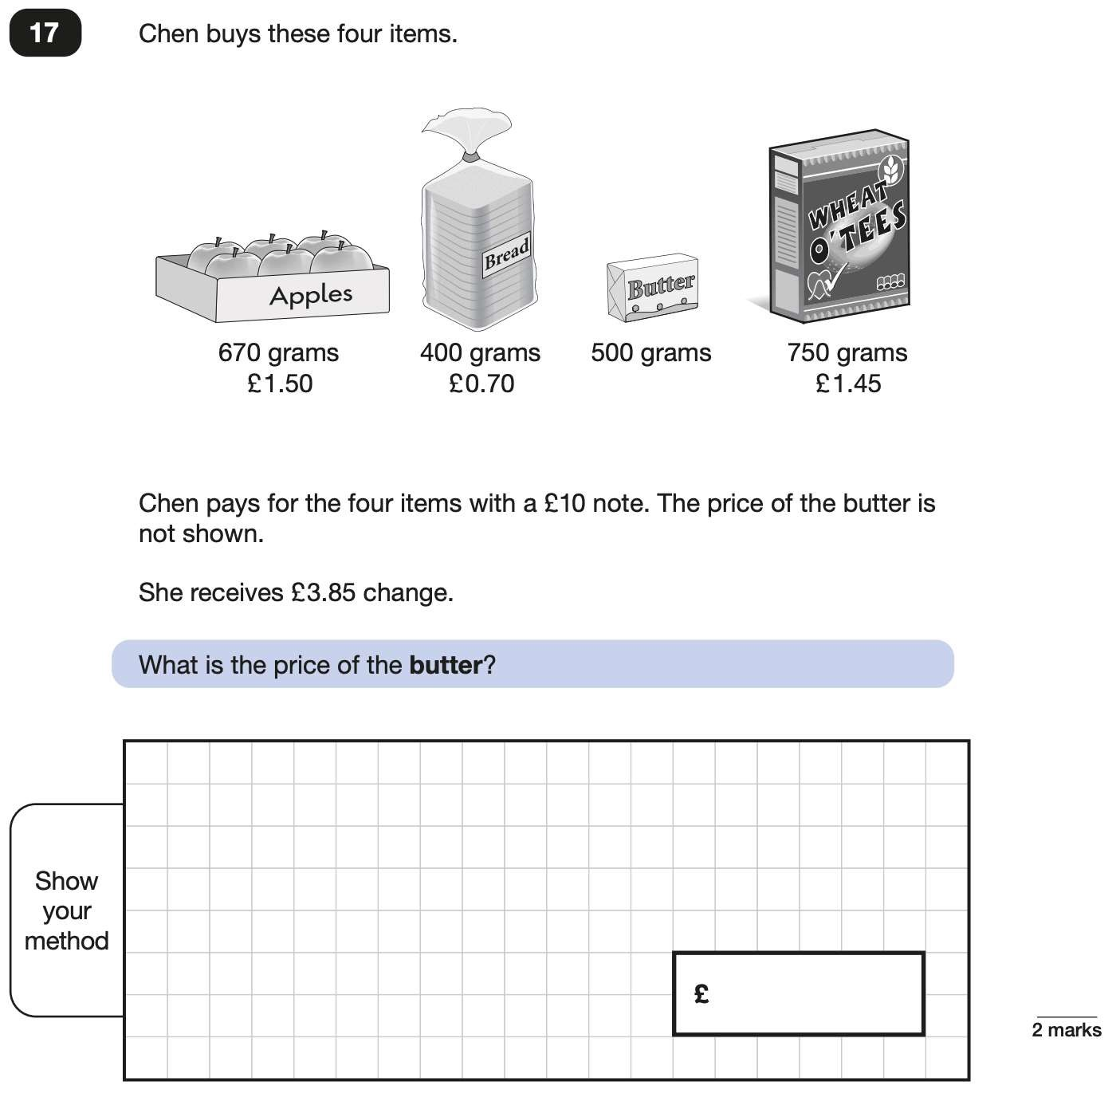
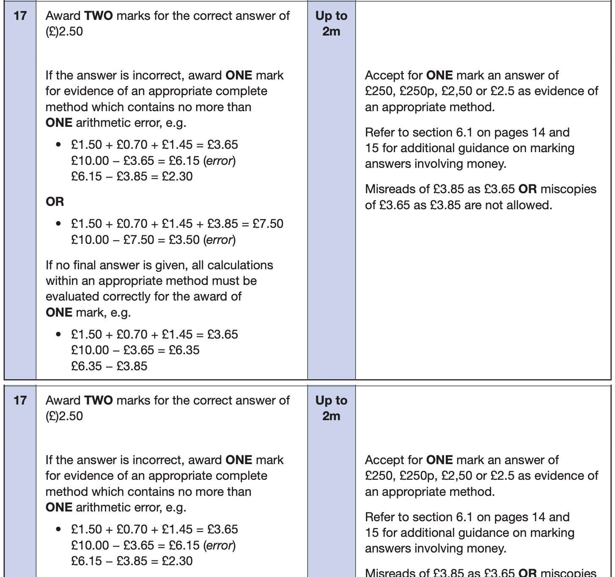
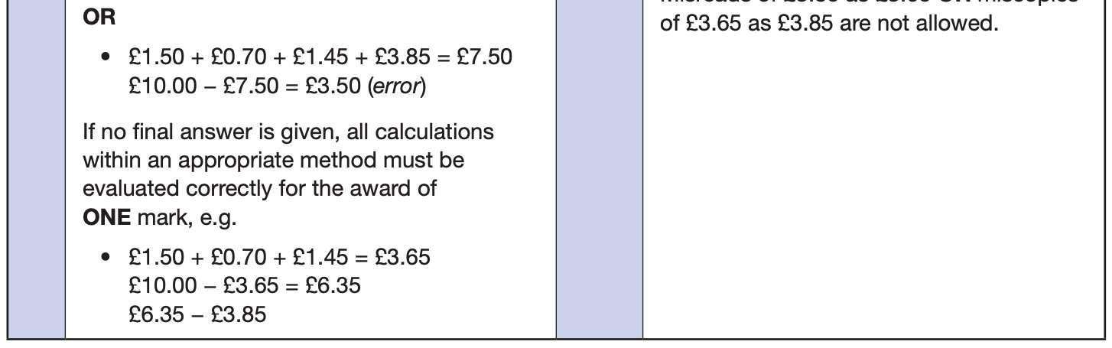

Slide 22
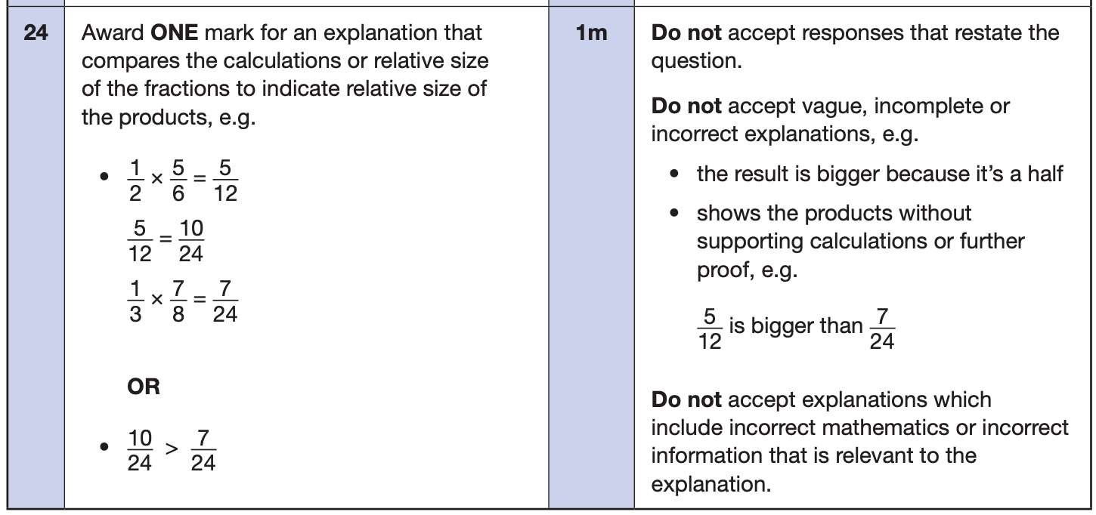
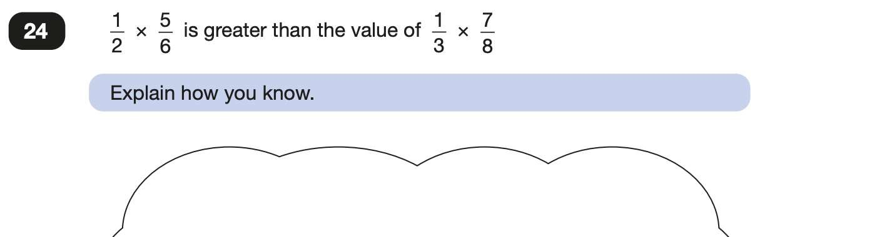


Slide 23
Supporting your child in preparing for the SATs
Firstly, a positive attitude goes a long way. Give them as much encouragement and support as you can.
Tips:
Don’t use past papers as they are used in school to prepare the children.
Attend any SATs meetings at school (or read any literature sent home).
Talk to your child’s class teacher if you have any concerns rather than worry your child.
Encourage your child to talk to their teacher or a trusted adult (including yourself) about their anxieties. Don’t forget that a small amount of anxiety is normal and not harmful.
Give your child a quiet, distraction free space to complete homework or study.
Ensure your child is eating and drinking well and getting a good amount of sleep.
Plan something nice and fun for the weekends before and after SATs. This will help them to relax before the SATs and give them something to look forward to after.

Slide 24
Further tips:
If you choose to ask your child to revise at home, keep revision light. Going over key skills (times tables, real world mental maths as you are shopping or cooking) is a good way to keep revision light.
As we said before, avoid using past papers. There are plenty of free or inexpensive SATs practice materials for parents available.
If you’re looking to support your child further with maths at home, there are lots of good websites with free Year 6 revision resources. On our class page, I have put a link to different websites that are good for revision.
Ensure your child attends the free (funded by PTA) breakfast club during SATS week.

Slide 25
Things to remember about SATs
SATs focus on what children know about Maths and English.
They will not reflect how talented they are at science, geography, art, PE…, and they certainly won’t highlight all their amazing personal characteristics.
SATs don’t tell the whole story.
SATs are only four days out of a whole Primary School career.

Slide 26
Advice for Year 6 children
Listen to your teacher.
The adults you work with all want you to do your best.
Get plenty of sleep and eat well, this will help your brain.
Read all the questions carefully. This can help you to avoid silly mistakes.
Don’t panic. There may be questions you think you can’t answer. Take a deep breath. Read it again. You can always move on and go back to it later. It’s often better to write something rather than nothing.
Remember that the Year 6 SATs last for 4 days out of your whole life!
“Stay focused in class so you don’t have loads of extra studying to do at home!” – Year 7 pupil’s advice.

