Slide 1
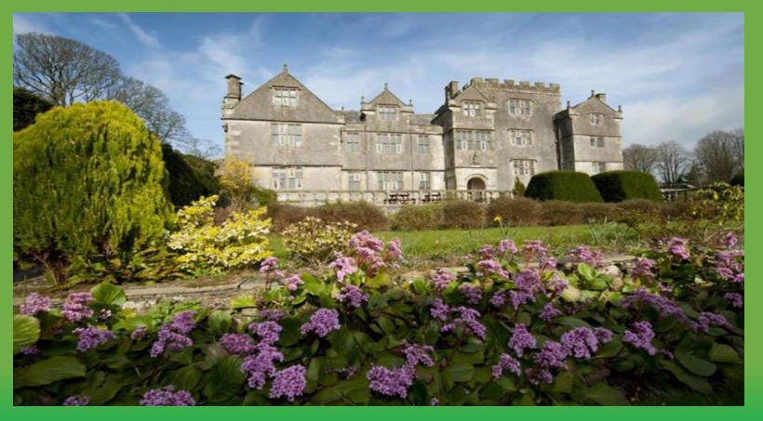
Borwick Hall
Monday 15th June to Wednesday 17th June

Slide 2
Explaining the Logistics
Monday 15th June 2026:
The children will arrive as normal to school at 8:45am.
• They will need to be dressed for activities as we will be doing one in the afternoon – a spare pair of clothes will also be needed in case the children get wet.
• Upon arrival to school, the children will drop their bags off in the school hall.
• Any medicines need to be handed over to the staff accompanying the children on the trip.
• The children must also have a packed lunch with them in a clearly labelled plastic bag.
• After registration, the children will get on the coach at 9:30am.
• You are more than welcome to wave the coach off if you wish…

Slide 3
Monday 15th June 2026:
• We will arrive at Borwick (traffic permitting) at 11am.
• We will leave our bags in a safe and secure place before having a tour of the grounds and our lunch.
• After we have had our lunch, we will do our first activity.
• Later on in the afternoon, they will be shown to their rooms to unpack and make their beds. We will also have our evening meal.
• After a little bit of free time getting used to the building, we will do an evening activity. This will likely be orienteering.
• At around 9pm, we will come inside and have some juice and a biscuit.
• The children will be sent to their rooms at 9:30pm with lights out being around 10pm.

Slide 4
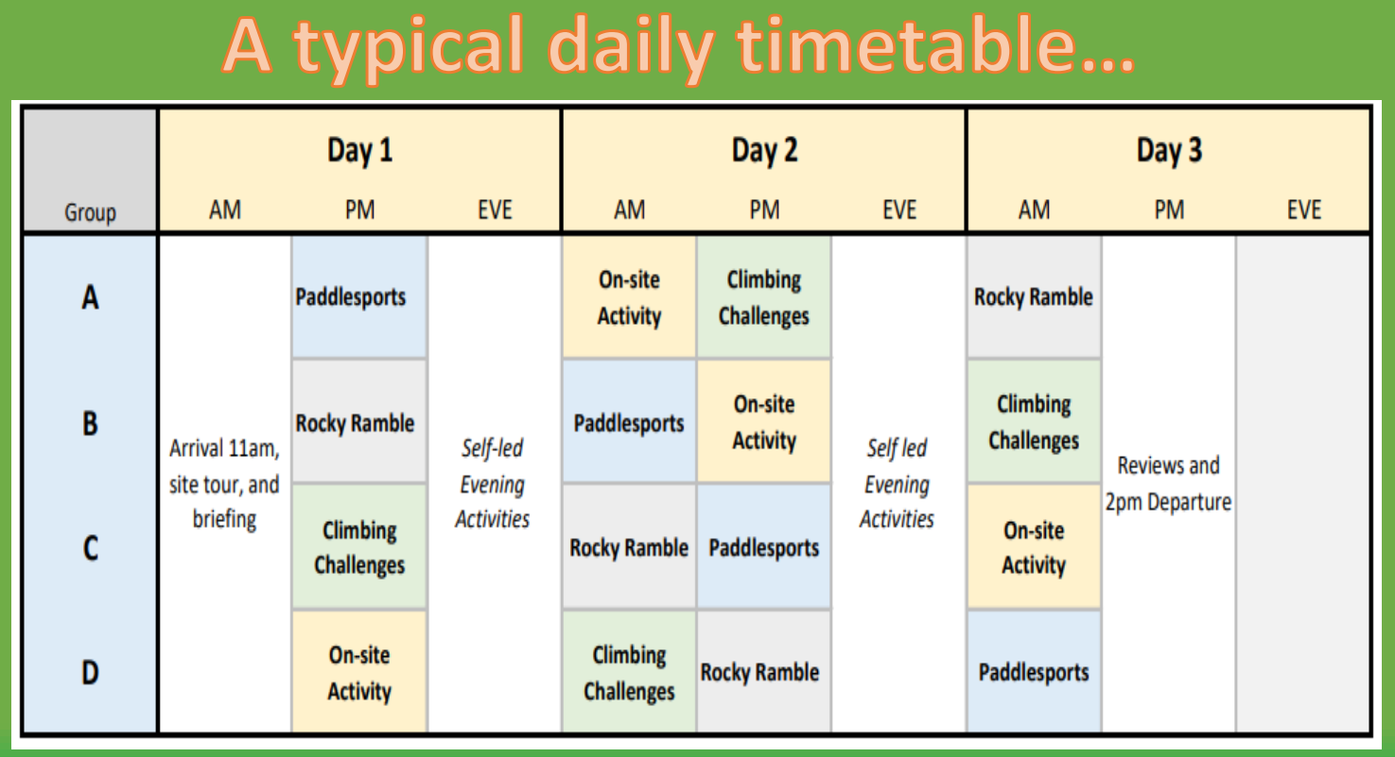

Slide 5
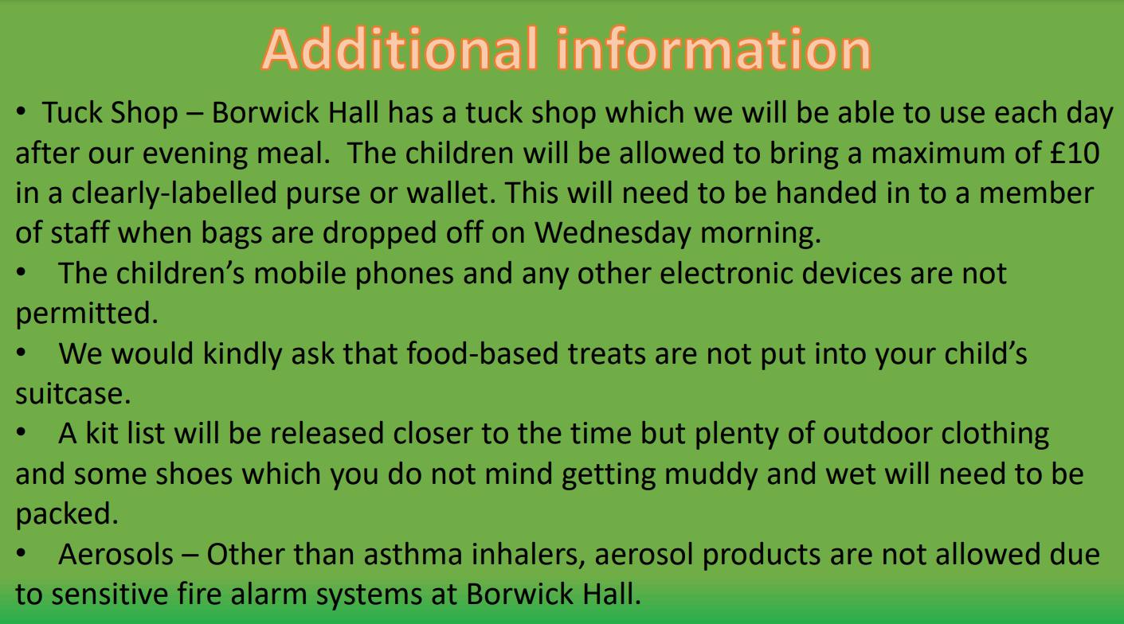

Slide 6
Contact during visit
Parents will be updated with messages and photos through Class Dojo.
Please make sure you are contactable during the residential in case of an emergency.
Staff will be taking a school mobile phone which can be contacted in an emergency.

Slide 7
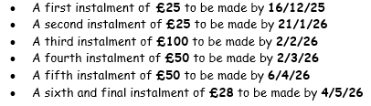
A reminder about payments….
The cost of the trip is £278

