Slide 1

Class 6
2025/2026
Parent Information

Slide 2
Class routines
Morning – pupils enter class and can silently read, practise their handwriting or complete a maths or literacy challenge on the board.
If they need to complete any work or they have any next steps, they have ‘fix-it’ time in the morning to complete this.

Slide 3
Maths
Guided reading.
English including grammar, punctuation and spelling.
Lessons - mornings

Slide 4
Afternoons follow this typical pattern:-
Monday – R.E. and P.E.
Tuesday – Science and P.E.
Wednesday –Art/DT and French/P.S.H.E with Mrs Younis
Thursday – Computing and Music with Mrs Younis
Friday – R.E. and Geography/History
Lessons - afternoons

Slide 5
P.E.
P.E. is on a Monday and Tuesday.
Pupils should bring P.E. kits into school Monday and leave them for Tuesday.
Please can uniform be labelled.
No earrings.

Slide 6
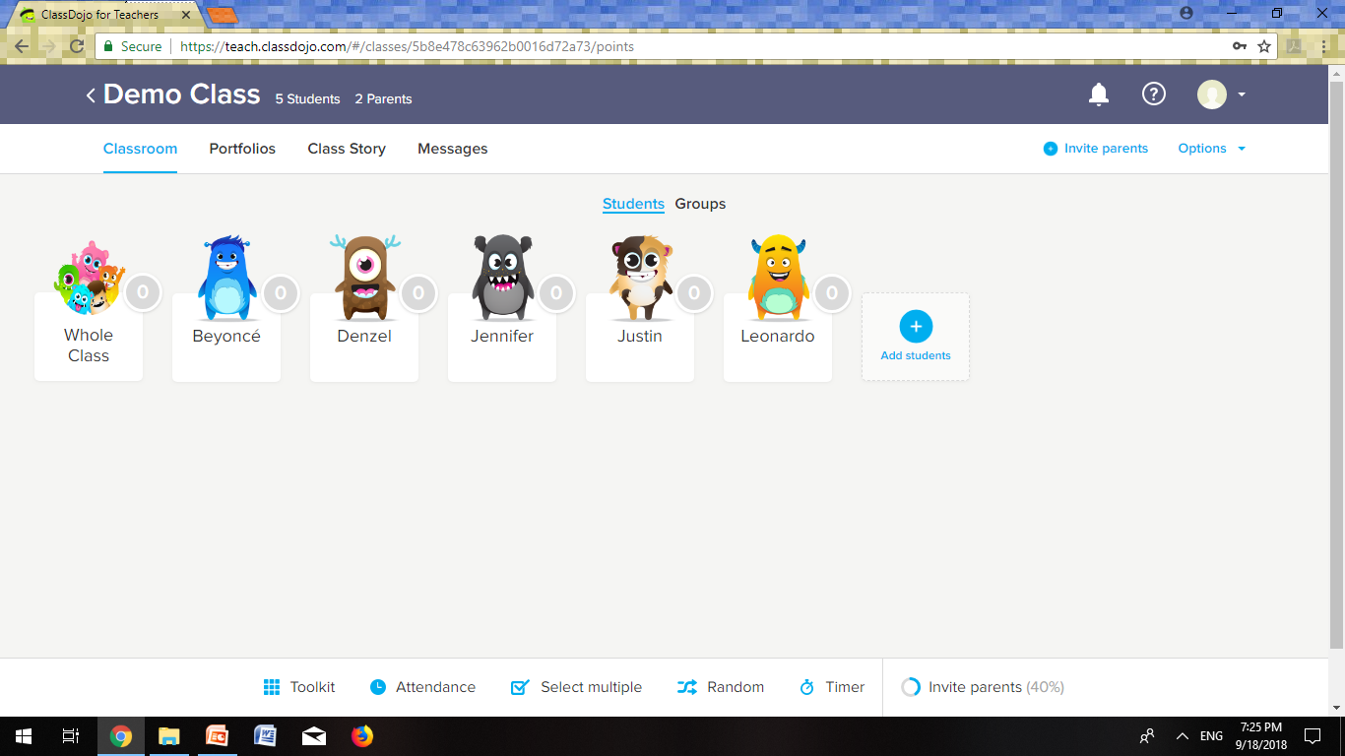
Class Dojo
In school, each class will be using Class Dojo for communication with parents about learning and rewards with pupils.
Pupils will be rewarded for positive behaviour and working hard in lessons. Pupils will receive Class Dojo points.
The pupil with the most
Dojos can choose a prize for
the following week –
e.g. Bring a small teddy into
school or wear their slippers
in class.

Slide 7
Homework
Homework will consist of one piece of Maths, one piece of reading and one piece of grammar each week. There will also be some writing tasks set alongside these, but the children will be given longer to complete these.
Spellings will be tested on a Friday.
Homework will be set on Friday for the following Friday.
On the website will be a list of Maths and English websites that you might find useful for additional homework or revision.

Slide 8
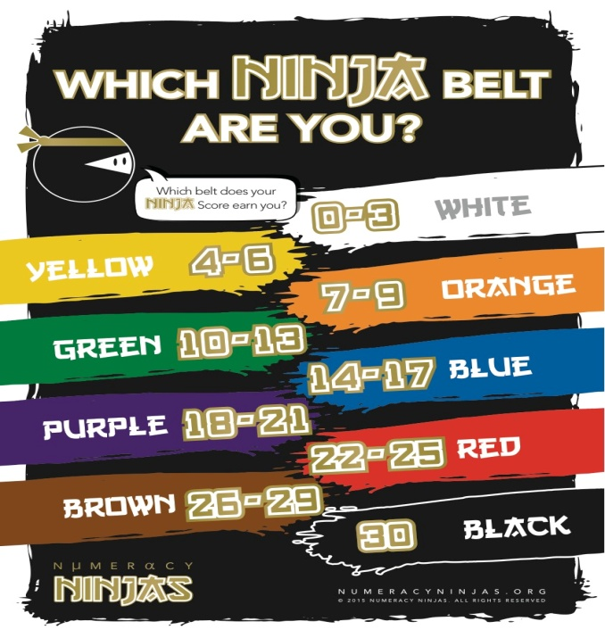

Times tables and arithmetic
We will be continuing to use Rock Star Times Tables to help us become faster at our multiplication and division recall.
We will also be using Numeracy Ninja in class to improve and speed up our arithmetic skills.

Slide 9
Reading
Try to listen to your child read as often as possible.
Children have free reading books in their tray and will bring one home to read.
Children can bring in their own books to read as long as they are age appropriate and try to challenge/stretch them.

Slide 10
Equipment
Pupils do not need to bring in any other pieces of equipment / stationery.
Pupils not to bring in mobile phones unless absolutely necessary.

Slide 11
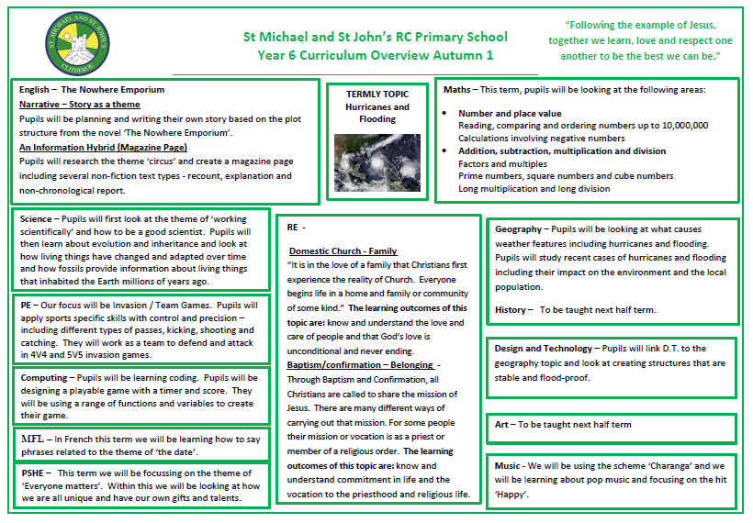
Topic
For this half term our topic theme is ‘Hurricanes and Flooding’.
Topic overview for this half term will be available on the school website and on Class Dojo.

