Slide 1

Sports Council 2021/22
Our Sports Council this year consists of two children from each class.

Slide 2
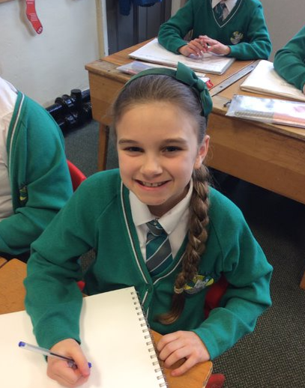
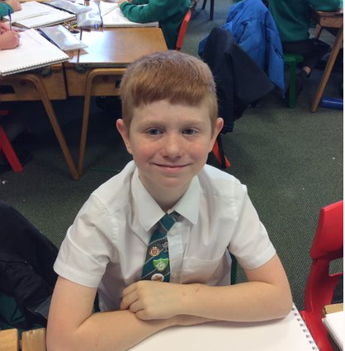
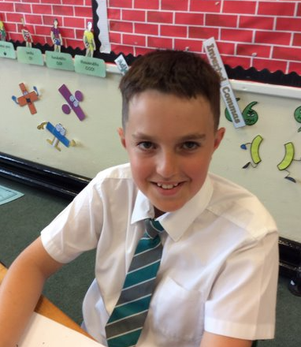
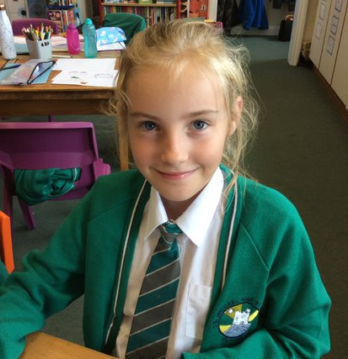
Meet some members of the Team

Slide 3
Our Job!
Our job is to meet with our classes and find out all about what sports, PE and fitness they would like to see in our school.
The aim of the Sports Council is to raise the profile of sports, both inside and outside school, for all children.
We give PE a voice!

Slide 4
What we have achieved this year so far?
Increased amount of resources on the playground-We surveyed each class about equipment they would like at break times- break times have since improved and lots of children are enjoying new games with the equipment.
Year 5 trained at Play Leaders- The plan is to develop this further during the final term and next year.
Engagement in competitions as a school-We have all represented the school for various sports teams and are proud to do this-we model what we expect!
Further links with the local sports clubs-Year 5 BRFC
An assembly a term!- Passing It On Summer 1
Being involved in Sports Day 2022- meeting this week

Slide 5
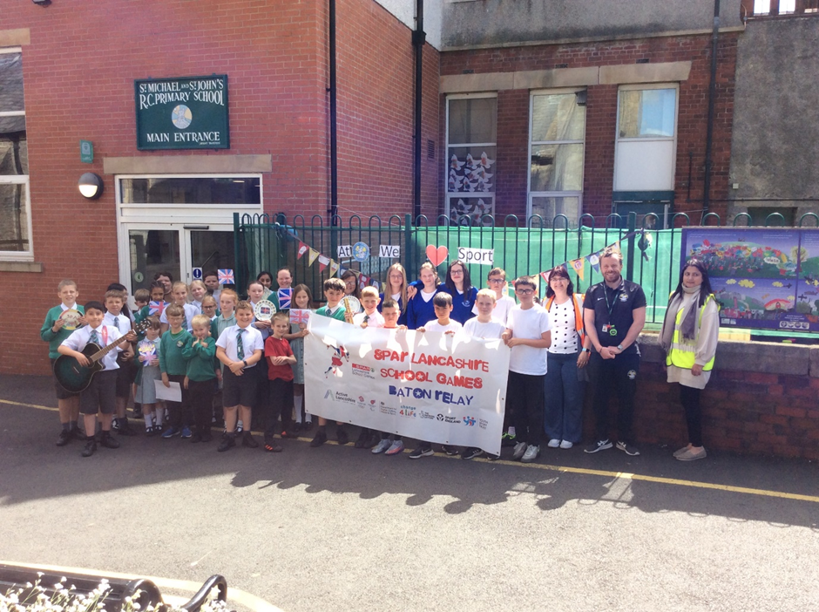
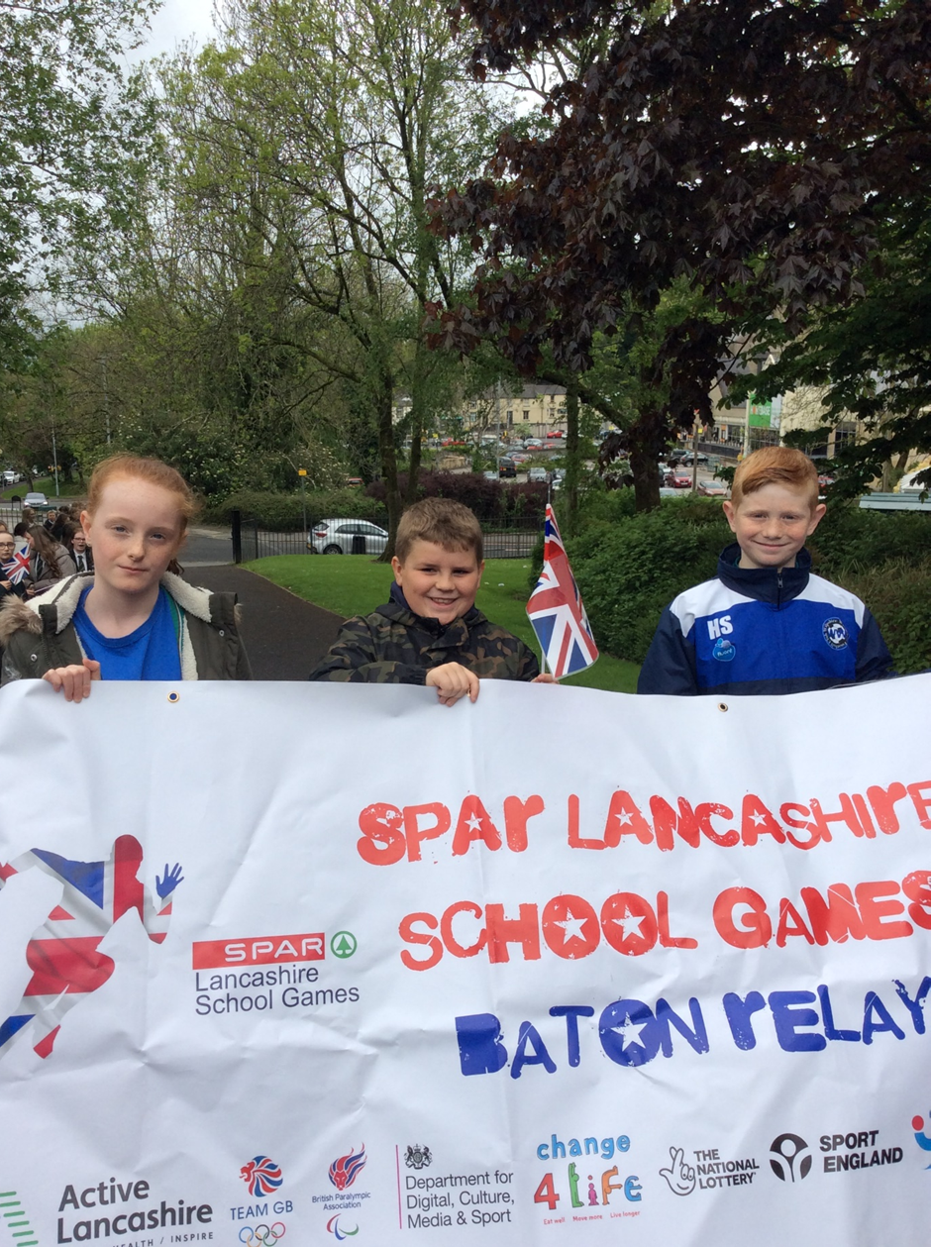
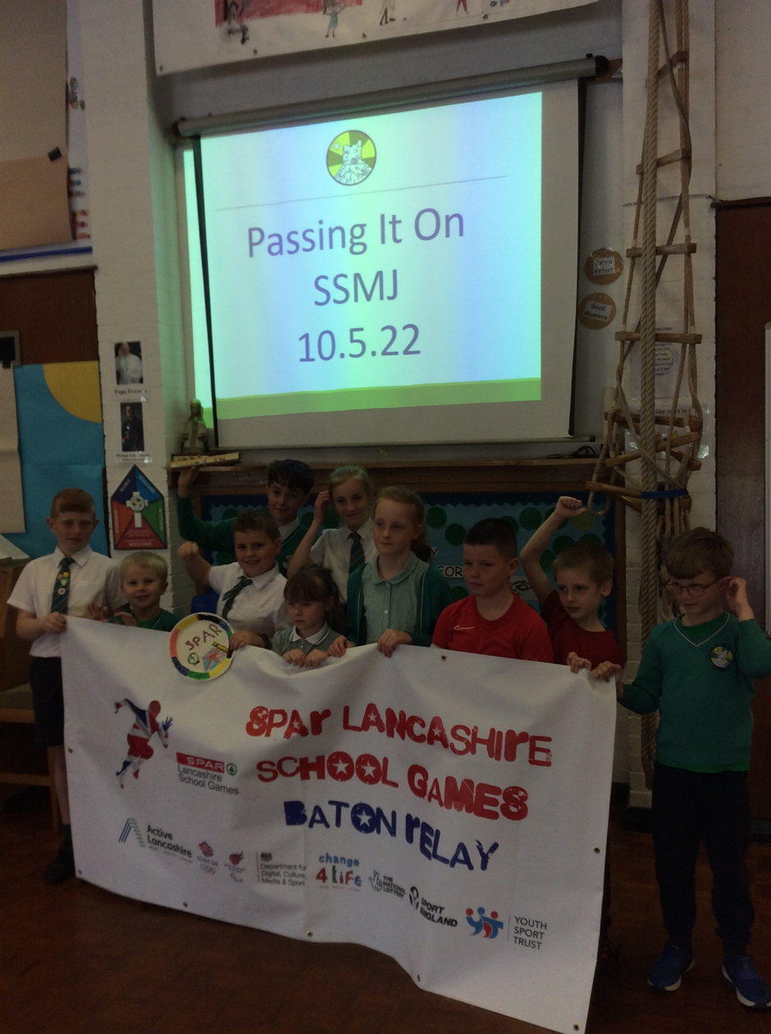
The Spar Games Baton
On Tuesday the whole school came together to celebrate the arrival of the Spar Lancashire School Games Baton. Members of our Sports Council along with Year 6 received the baton from children from St James. It was then taken to the hall where a special assembly was led titled “Passing It On.” The Sports Council highlighted the importance of sport and key values linked to sport!
On Wednesday me, Amelia and Coby took the baton on its next leg of its journey to Ribblesdale High. Along with Mrs Wilkinson we were greeted by a Samba Band and received a warm welcome from many of the students and staff.
The baton will visit 57 schools in all!

Slide 6
Future Projects
Develop further sports at SSMJ
Increase the number of clubs at SSMJ
Make our break times more fun
Be sporty
Be recognised as a SPORTING SCHOOL.
Wellbeing Warriors

Slide 7
Let us finish with a prayer
God, let me play well but fairly.
Help me to learn something that matters
once the game is over.
Let competition make me strong but never hostile.
Always let me help my opponent up.
Never catch me rejoicing in the adversity of others.
If I know victory, allow me to be happy; if I am denied, keep me from envy.
Remind me that sports are just games.
If through athletics I set an example,
let it be a good one. Amen
Saint Sebastian, Patron Saint of Athletes, pray for us.

