Slide 1

How to contribute to
‘Living Sustainably’
at SSMJ
https://circularcomputing.com/news/10-ways-make-school-sustainable/
1. Active environmental learning:
Get your pupils involved in active learning about the environment.
2. Recycling as a craft exercise:
Rubbish exists. It is all around us. Before discarding those broken headphones or plastic bottle caps, give Pinterest or Google a quick search for creative ideas to repurpose them.
3. Classroom composting
Food waste is the biggest occupant of landfills in the UK. When food rots, it emits methane (CH₄), a greenhouse gas many times more potent than carbon dioxide (CO₂). If we are serious about fighting climate change, then food waste should be a central focus.
4. Re-use paper
Using both sides of your classroom paper is ideal. Keeping a “one-sided copies” bin handy helps make sure you are not recycling paper before it is used up.
5. Using sustainable IT
Brand new IT is costly. Not only in terms of your school’s budget, but to the planet.
6. Start a school gardening project
Teaching students about the food they eat takes on a whole new meaning when they grow it themselves.

Slide 2
How to contribute to
‘Living Sustainably’
at SSMJ
Conclusion: sustainability is within your reach
6. Start a school gardening project
Teaching students about the food they eat takes on a whole new meaning when they grow it themselves.
7. Energy efficiency
Energy efficiency is not as arduous as it sounds.
Turn off school lights and shut down your computers at the end of the day. Keep your classroom doors shut to stop heat escaping and do not block heaters. Check the energy consumption of your appliances and make it a major consideration when buying new ones and always purchase energy efficient light bulbs
8. Advocate zero waste at school events
When it comes to sustainable school grounds, don’t forget the events where not only your pupils attend, but the whole community leaves their larger green footprint.
9. Use environmentally friendly cleaning products
Start by cleaning with green products in your classrooms. Read the labels and be aware of any of them that have cautions or warnings.
10. Encourage walking to school
Walking is a great form of exercise; it invigorates and can be very therapeutic.

Slide 3
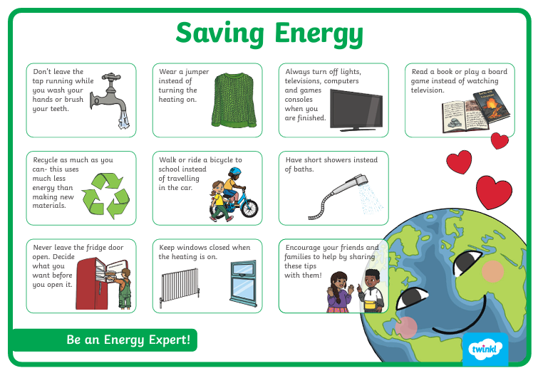

Slide 4





Save Energy
Turn off lights
Do you need your projector on?
Can you turn it off at break/lunch/before/after school/PE/Worship?
Turn off lights
Throughout School (Not just your classroom)
Do you need your lights on?
Can you have half of your lights on?
Can you turn them off at break/lunch/before/after school/PE/Worship?
Close Doors
Do you need your door open?
Turn off
computers
Close Windows
Do you need your computer on?
Do you need your window open?

Slide 5
Resources/Ideas
Document published by Government 2012 but points are applicable (Top tips for sustainability in schools) : chrome-extension://efaidnbmnnnibpcajpcglclefindmkaj/https://assets.publishing.service.gov.uk/government/uploads/system/uploads/attachment_data/file/187037/DFE-32056-2012.pdf
https://www.cobis.org.uk/our-network/blog/blog-demo-page/~board/blogs/post/6-ways-to-make-your-school-more-sustainable
https://www.hertsforlearning.co.uk/blog/steps-sustainability-10-minute-guide-greening-your-school
https://www.ourendangeredworld.com/eco/teaching-sustainability/

