Slide 1


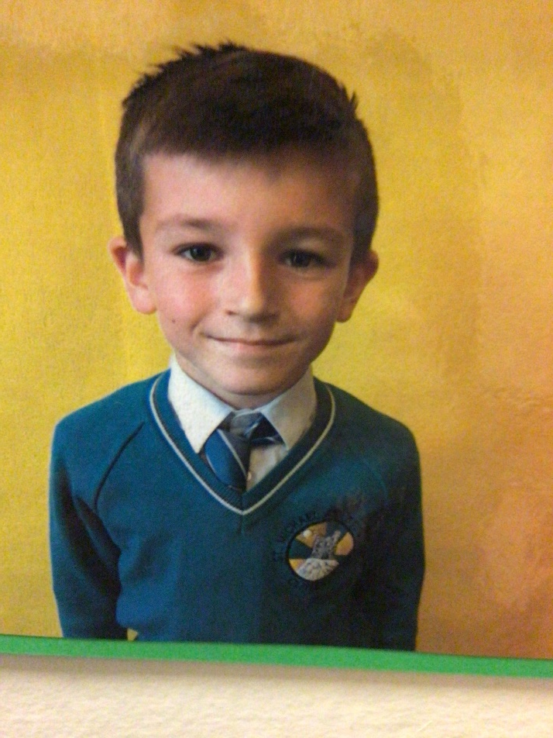
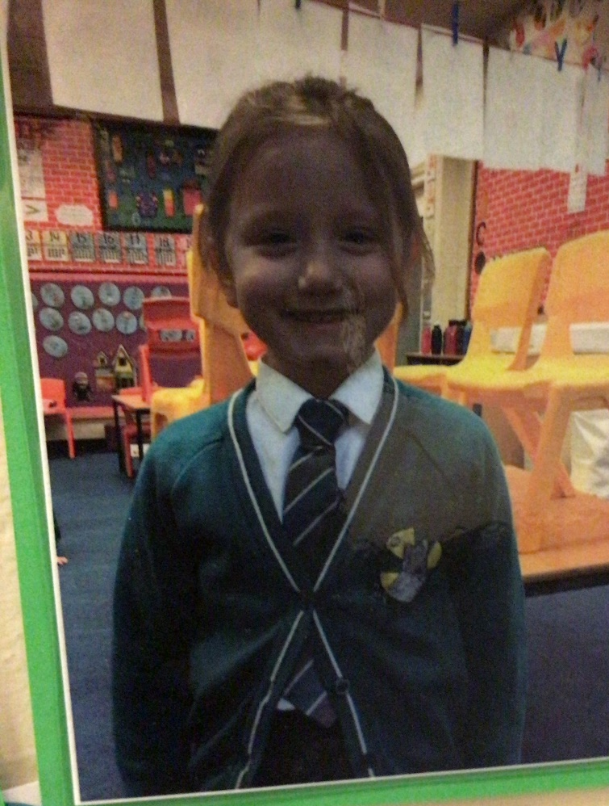
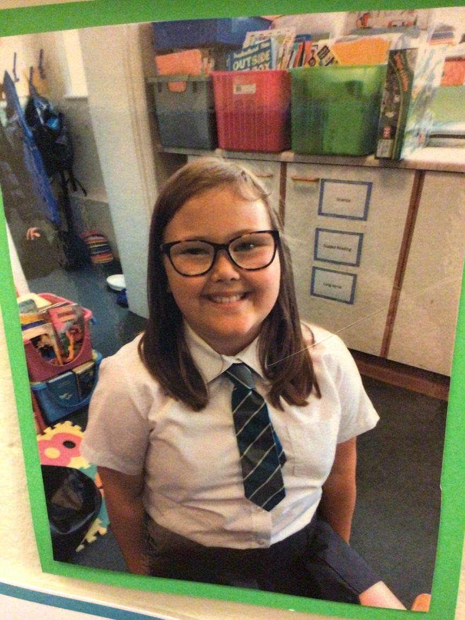
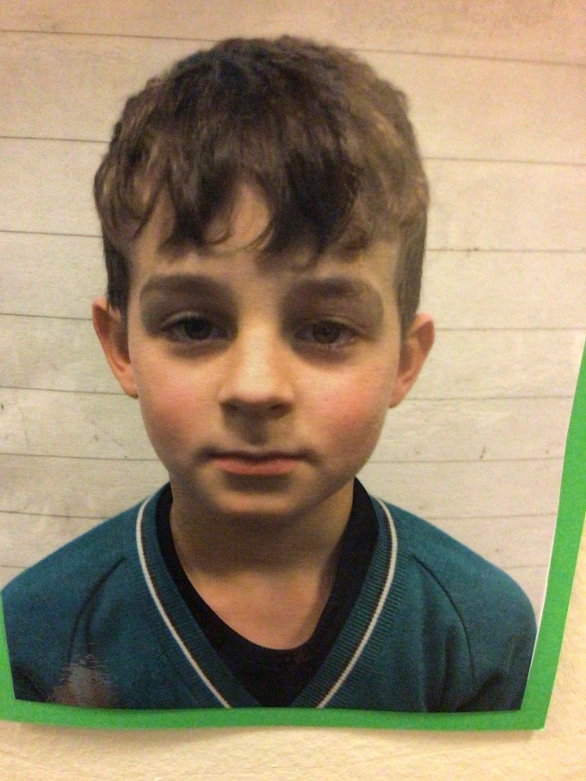
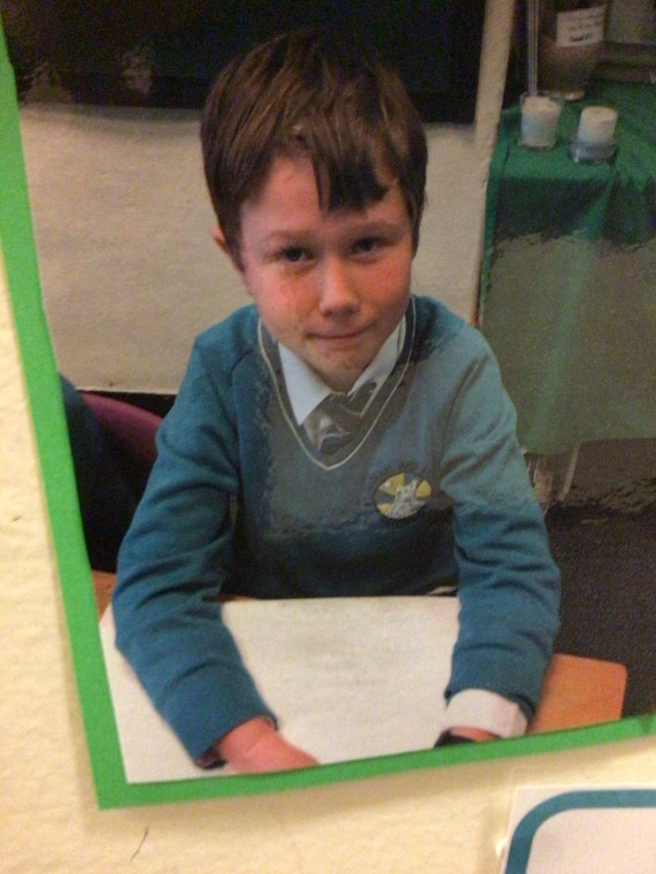
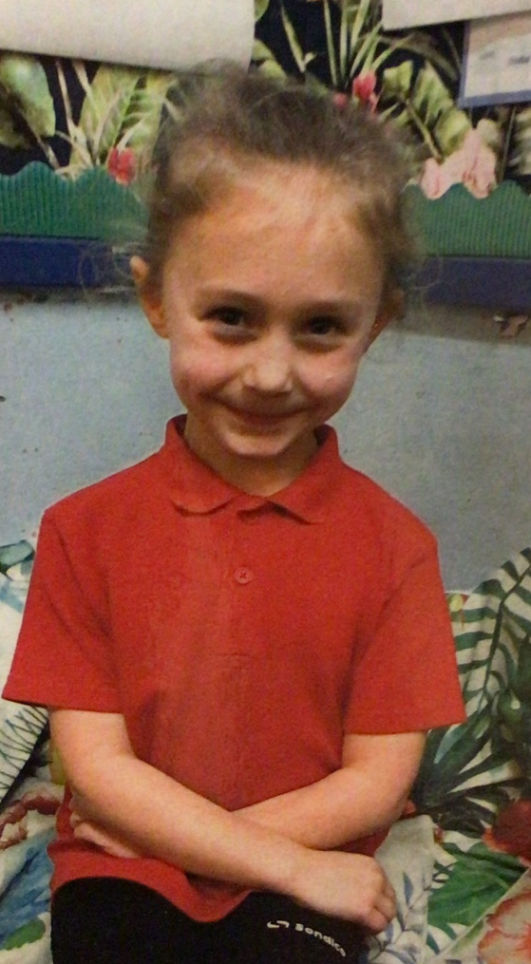
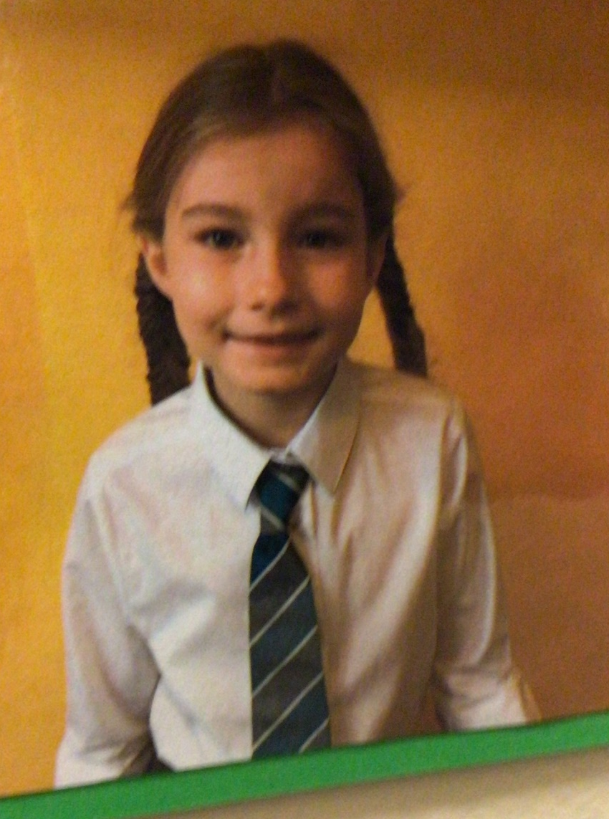
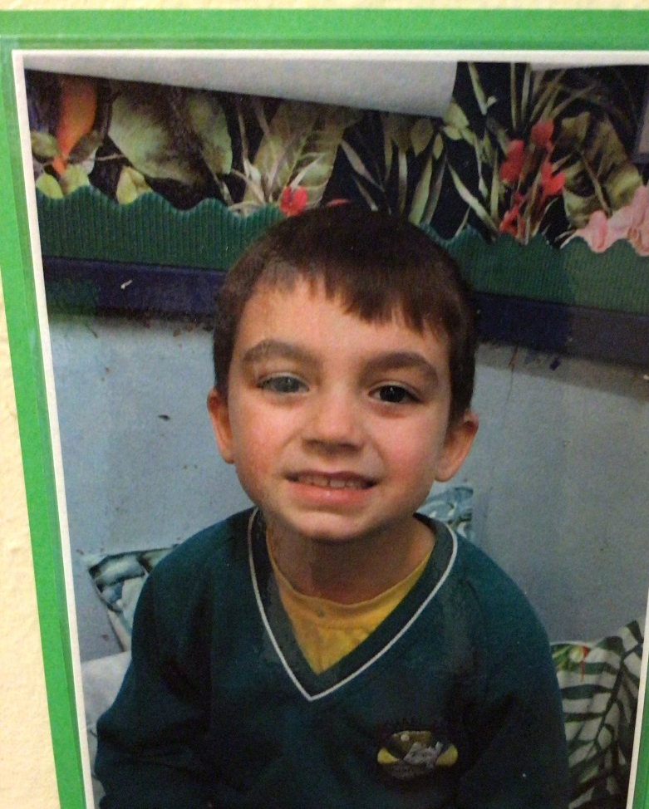
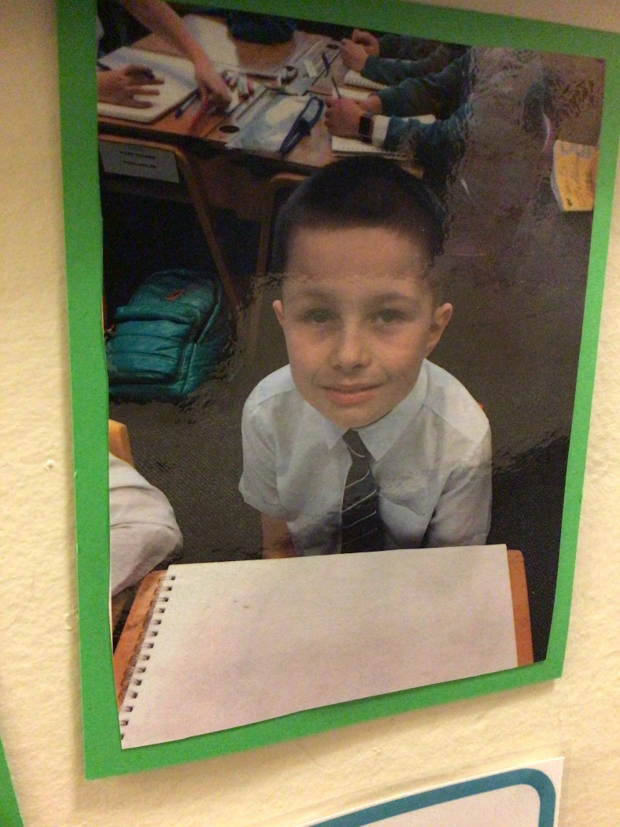
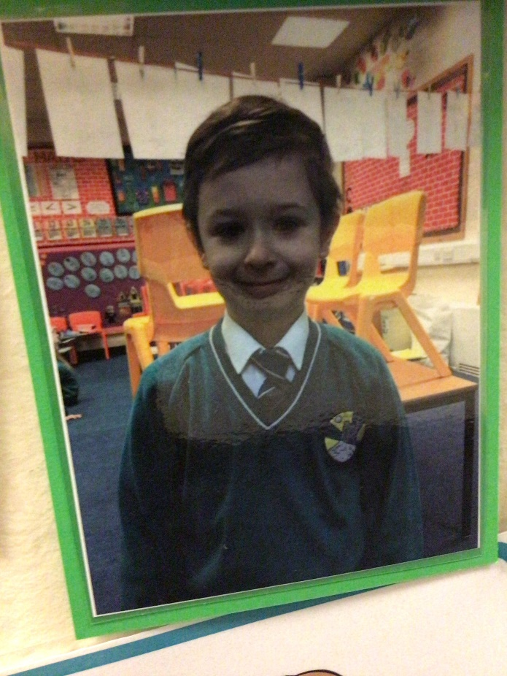
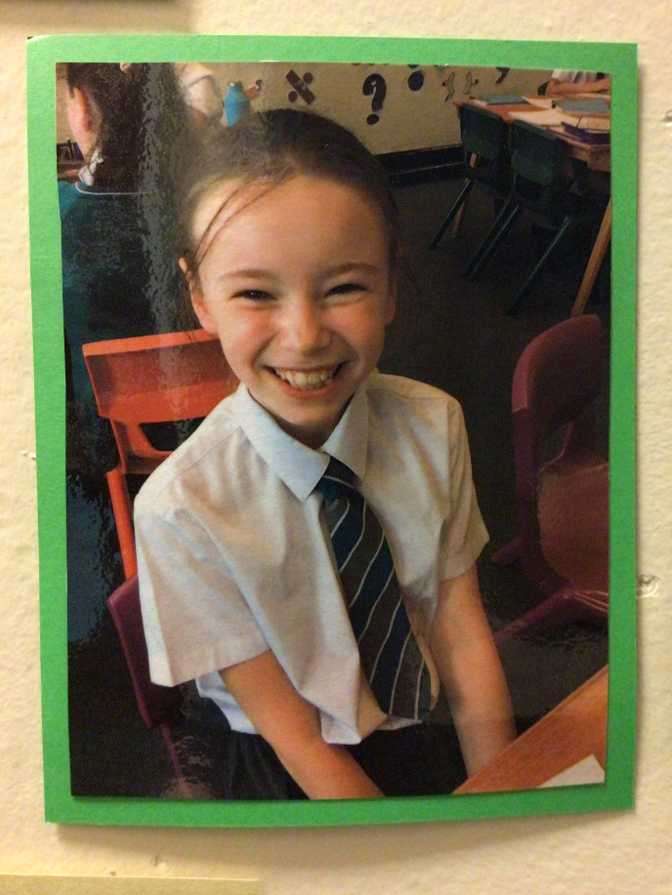
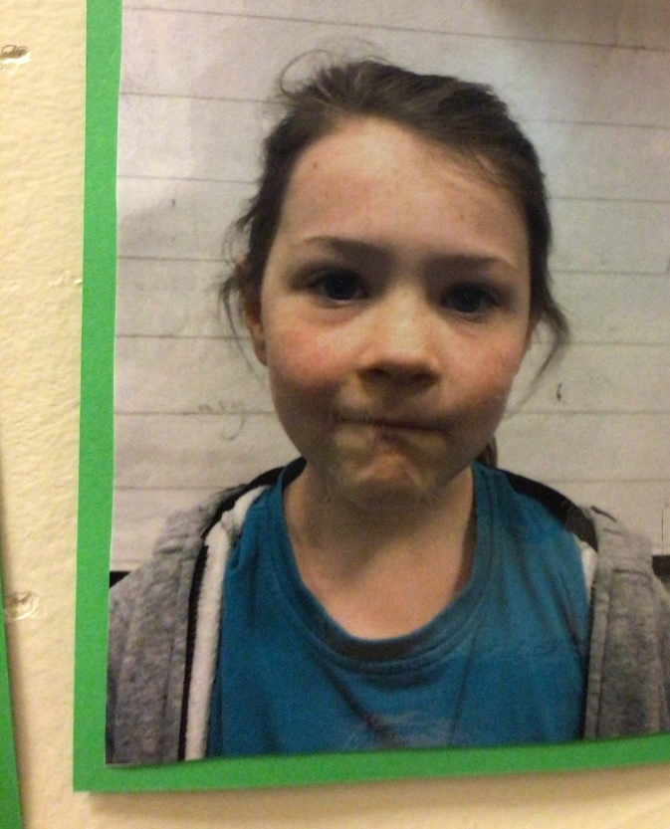
We gather…
Laudato Si’

Slide 2
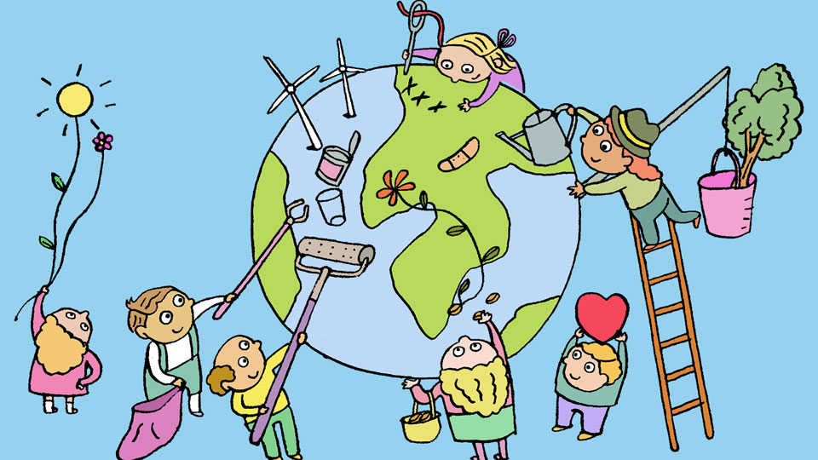
We gather…
Laudato Si’
Caring for our common home

Slide 3

We gather…

Slide 4
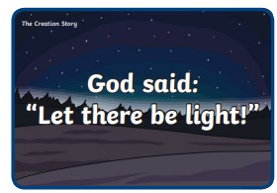
We gather…

Slide 5

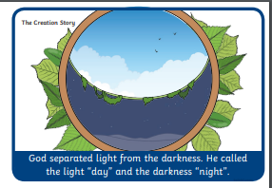
We gather…

Slide 6
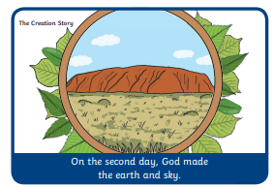
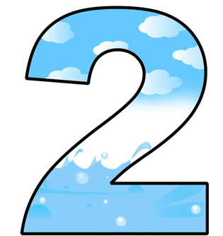
We gather…

Slide 7
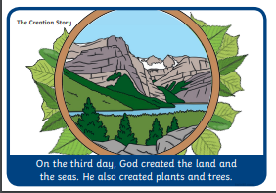
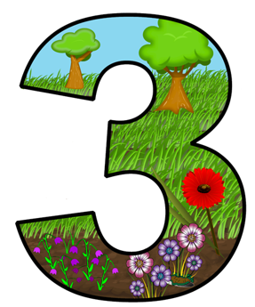
We gather…

Slide 8
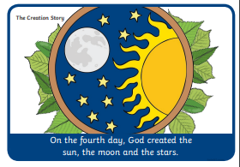
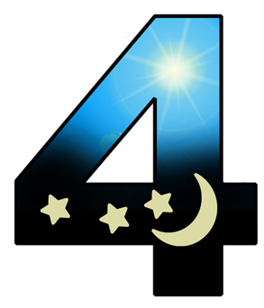
We gather…

Slide 9

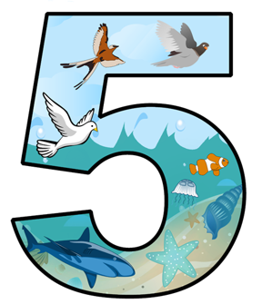
We gather…

Slide 10
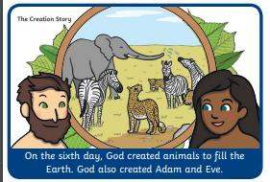
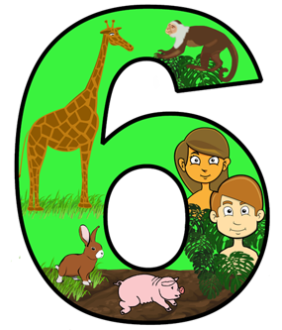
We gather…

Slide 11
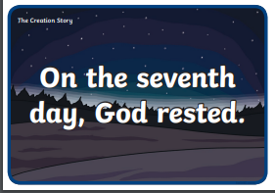
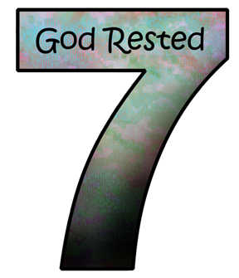
We gather…

Slide 12

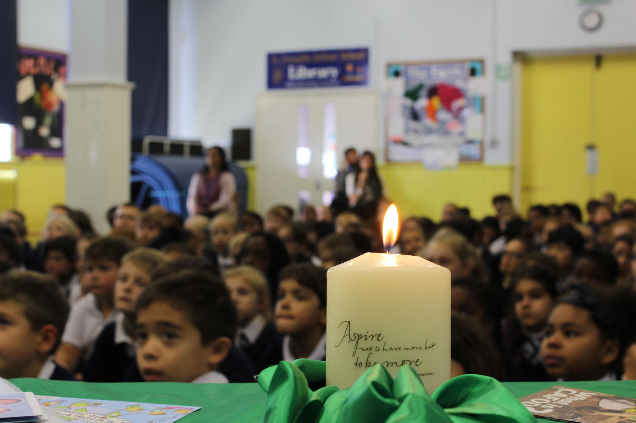
We listen…
A reading from the book of Genesis.
“God looked at everything he had made and was very pleased.”

Slide 13

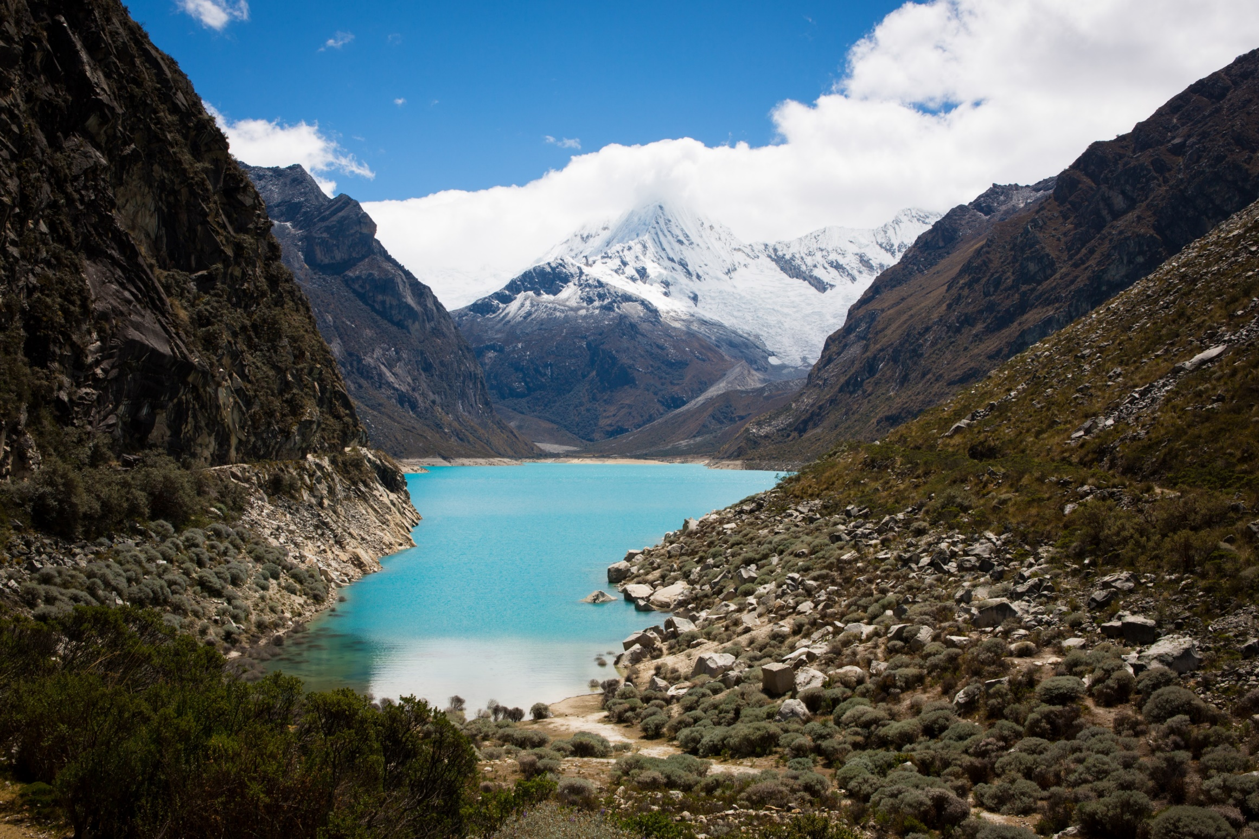
We respond…
Why do you think that God was pleased with the world?
What do you love about our world?

Slide 14
I like the birds soaring in the sky, they are fascinating.
Josh
I like the dense forest, there is so much life in it.
Carys
We respond…
All the animals because they keep our world together.
Chase
Why do you think that God was pleased with the world?
What do you love about our world?
Flowers everywhere, God must be pleased with those.
Rose
Our friends and family, they are all special to us.
Annabel

Slide 15

We respond…
Click the picture to watch the animation.
Notes:
Watch the animation here: https://www.youtube.com/watch?v=KOgF2Kgel6k

Slide 16
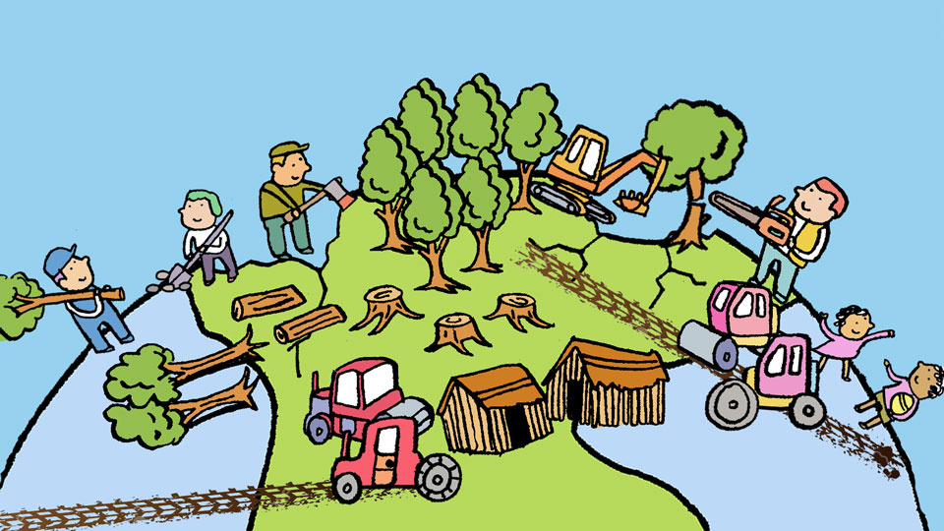
We respond…
What is Pope Francis asking us to do in his letter?
How does Pope Francis say we have treated the earth?

Slide 17
Remind people that small changes make a difference.
Carys
We respond…
What is Pope Francis asking us to do in his letter?
How does Pope Francis say we have treated the earth?
Think about how we can make a small change.
Annabel
Badly. We didn’t take care of it.
Chase

Slide 18
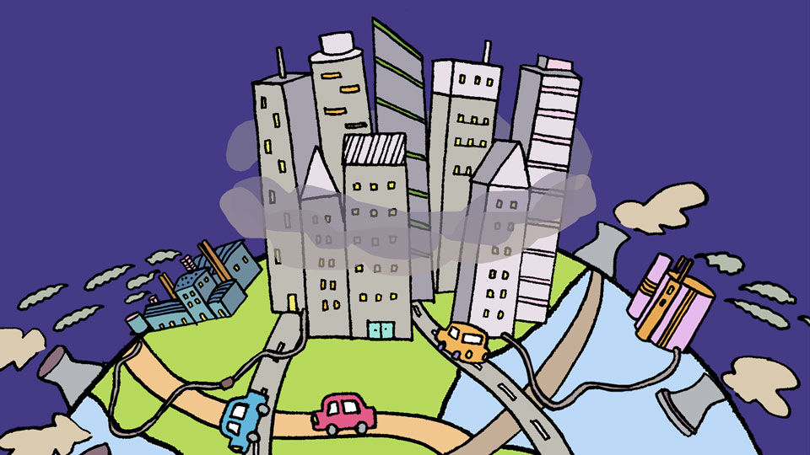
We respond…
What has happened to the earth because of this?
Why do you think Pope Francis wrote this letter?

Slide 19
It has been hurt and we need to mend it.
Hubert
We respond…
What has happened to the earth because of this?
Why do you think Pope Francis wrote this letter?
So we think about how we can help.
Una
So people listen and change.
Jacob

Slide 20
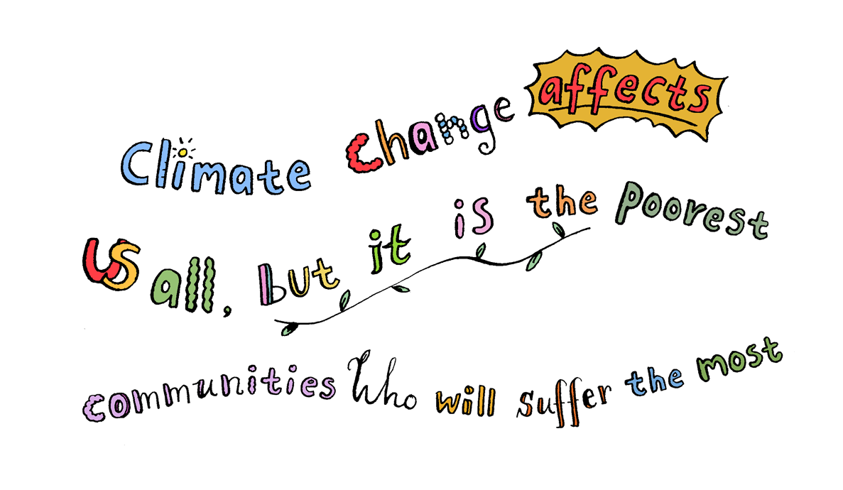
We respond…

Slide 21

Turn off taps
Going forth…
Turn off lights
How can we ‘Go Forth’ and help?
Think do I need that?
Don’t pick flowers,
grass, leaves
Recycle paper

Slide 22
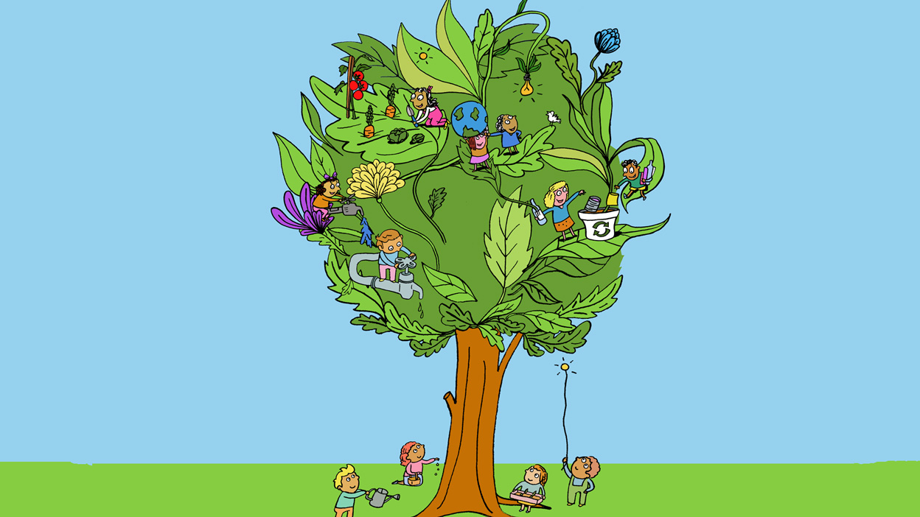
Going forth…
Lord in your Mercy…
Hear our prayer

