Slide 1

Student Council 2022/23
By Alexa and Harry

Slide 2
Content
Student Council Team
Our plan for the year
Disco
Harvest Appeal
Sponsored event
Ukraine Shoebox Appeal

Slide 3
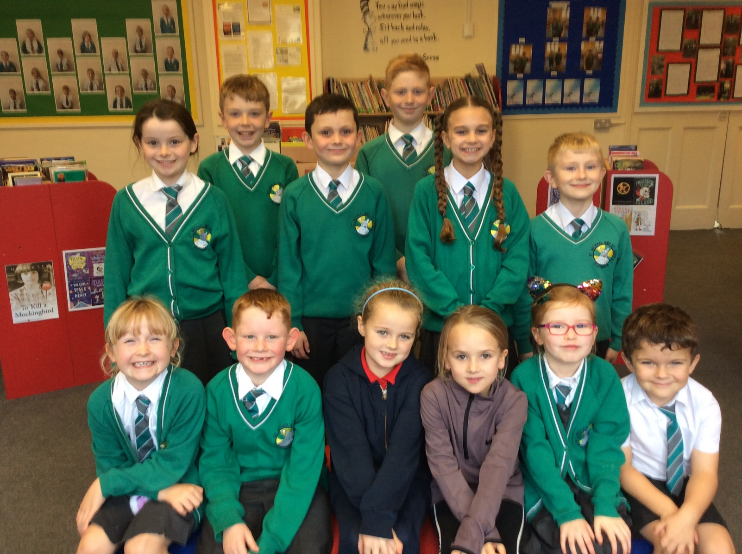
Meet the Student Council

Slide 4
Our plan for the year
Disco – Autumn
Harvest – Autumn Term
Parliament – Spring Term
Crazy hair day – Spring Term
Sponsored colour run – Summer Term
Summer Fair – Summer Term

Slide 5

Disco
£430 profit
Everyone had a great time

Slide 6
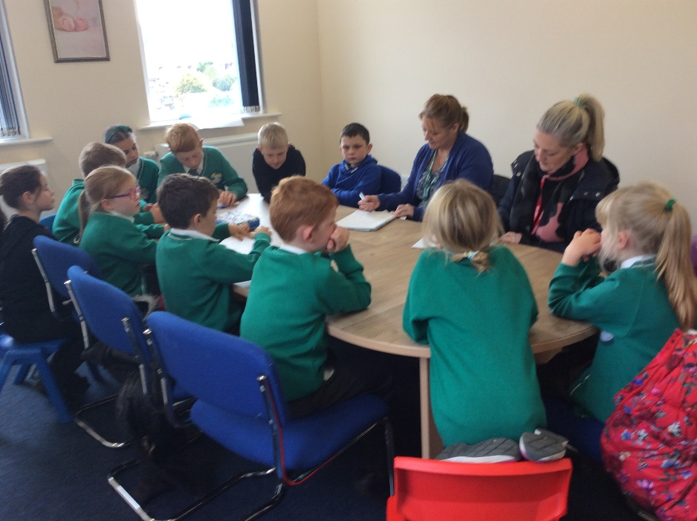
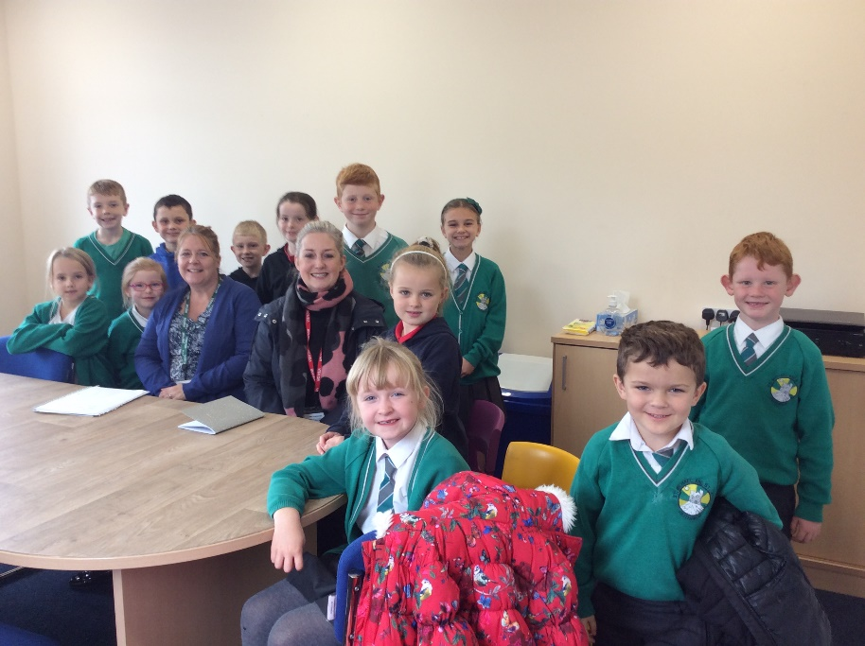
Meeting the PTA

Slide 7
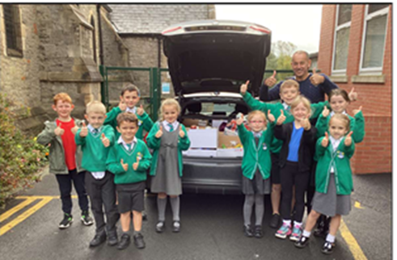
SSMJ Food bank (Harvest appeal)

Slide 8
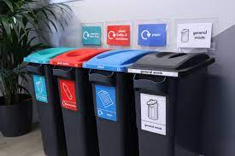

What we are fundraising for?
Working with the PTA we would like to fundraise for 15 ipads.
£400 x 15 = £6,000
Eco-council would like 2 x recycling bins

Slide 9
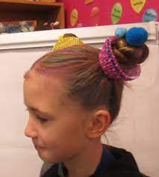
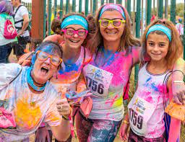
Fundraising events
Crazy Hair Day
Sponsored Colour Run – Friday after Easter

Slide 10



Shoebox appeal
ASAP
Ukraine shoebox appeal in partnership with Clitheroe Rotary Club.

Slide 11

DO YOU HAVE ANY QUESTIONS FOR US?

