Slide 1
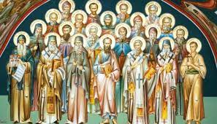
Student Council Drawing Competition
Draw a ‘Holy’ person from the Bible using pencils/coloured pencils.
There will be a winner chosen from each class and their artwork will be framed and hung on the wall outside of the office.
50p to enter
Deadline: Friday 23rd February

