Slide 1



My child has a POP….
What is a POP?
Notes:
welcome to this short information presentation about what a POP is and why we use them in school
This is a video to support the information available on your schools webiste in the SEN information report

Slide 2
What does the SEN Code of Practice 2014 say about record keeping?
It is for schools to decide their own approach in record keeping for SEN pupils.
The provision made for SEN pupils should be recorded accurately and kept up to date.
OFSTED will expect to see evidence of pupil progress, what outcomes are expected and a well informed approach to the monitoring and evaluation of the SEN support provided.
Schools should record:
  Additional or different provision for the pupil
  Accurate information about the pupil’s SEN
  The provision provided for the pupil including teaching strategies and the impact of this support
  Any involvement of specialists and when
This information should be shared readily with parents and be accessible to them.
Notes:
The code of practice is what we as a school need to follow regarding the care of children with SEND in school.
You can see from the information contained here that it is up to the school to decide how to record what support is in place for your child. This can take many forms and some schools use an IEP to record this information. We use a POP

Slide 3
We record this information in a POP
A POP is short for Pupil Overview of Provision
It contains:
  your child’s information about their strengths and challenges,
  the professionals involved in your child’s care,
  The support in place for your child:
    In the classroom
    In groups including interventions they take part in
    On an individual basis
  A review of the support in place for each term of the year by the adults in class, yourselves and your child
  Your child’s attendance will also be recorded on the document as well as their attainment through the year
The POP is a working document which means it is constantly changing throughout the year
Notes:
A POP is short for Pupil Overview of provision and it contains many elements to help everyone involved in your child's care understand what support is in place for them.
It contains - go through the slide info

Slide 4
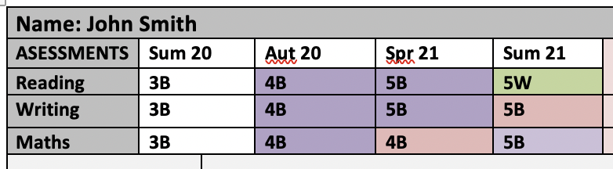
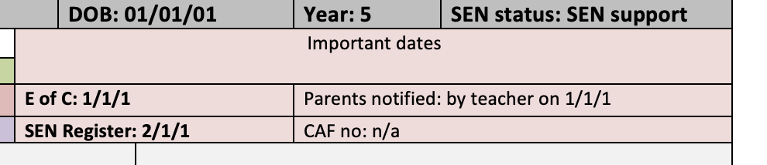
Your child’s information on the POP
Notes:
The first section of the POP will contain the basic information about your child - DOB, Year group, SEN status eg are they on the SEN register at SEN support level or do they have an EHCP.
You can find more information about the different SEN types in the SEN information report available on line.
It also contains information about their age related assessments - if you are unsure what the assessment information means please speak to your child's class teacher to explain this further.
It also contains important dates about when your child was placed on the SEN register and the date you were informed as well as if they had an expression of concern completed before they were placed on the SEN register. This is all part of the graduated response and is detailed in the SEN information report.

Slide 5
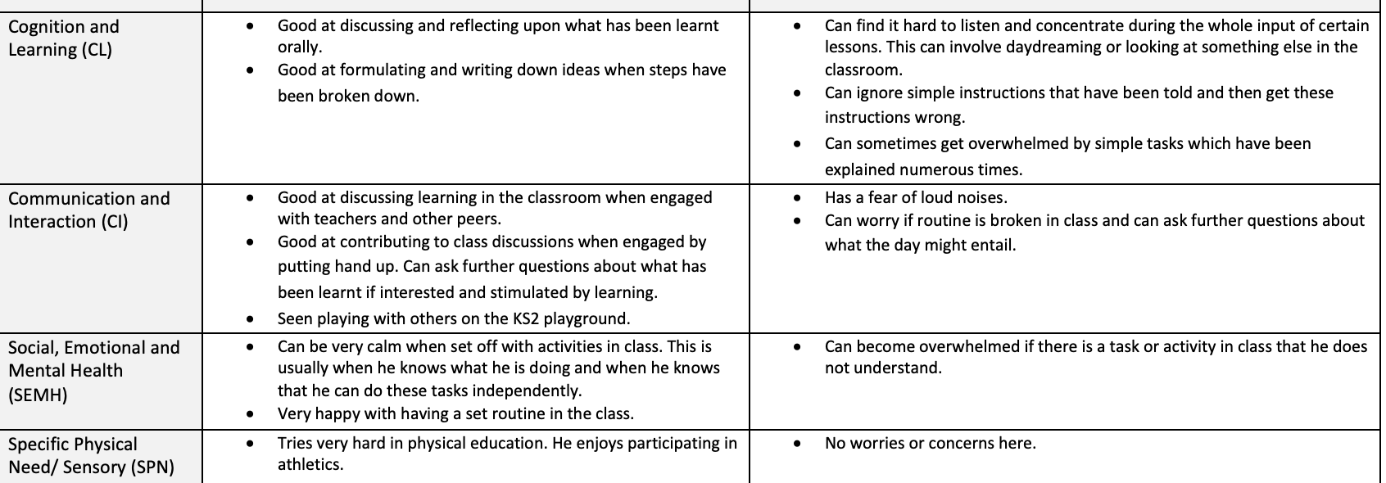
What strengths and challenges your child has
It is important that you add your thoughts as you know your child best
We need to always focus on what your child can do to help them with the things they find difficult
Strengths and challenges are discussed across the 4 areas of need as well as their independence and self-help skills. You can find more information about what the 4 areas of need are in the schools SEN information report
Notes:
Your child's strengths and challenges regarding the different areas of need are then bullet pointed for quick overview snapshot of your child. This helps to inform strategies school staff can put in place to support your child through the strengths they have as well as set targets and provide for the challenges they face.
It is important that you have input into this as you know your child best.

Slide 6
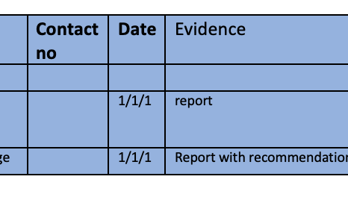
Which professionals are involved with your child
You can help school by making sure they have all the names of the professionals involved in the care of your child and any reports or letters not listed
Notes:
This section is an important area to keep updated as it contains the names and details of any professionals involved in your child's care and any advices they have given.
Please double check this area of your child's POP as sometimes letters do not come into school which means we are not fully aware of all of your child's needs. If there are names missing please talk to the school SENCO and provide any letters the school may not have.

Slide 7
What support your child receives that is in addition or different to their peers
This is shown in 3 different columns for each term of the year
  Quality first teaching strategies that will support your child in the classroom
  Group work interventions that will support and develop your child. These could be in the classroom or delivered outside of the classroom and they could be delivered by the teacher, or a teaching assistant trained in delivering the intervention
  1:1 support, which means any support your child receives by a teacher or teaching assistant on a one to one basis. It is important to develop the independent skills of your child, so we encourage children through scaffolding as much as possible.
This provision/support is then costed by the SENCo
Further information about the different types of provision/support the school provides is shown in our SEN Information Report
Notes:
This section of the POP changes every term and for each new term a new section is created in the document. This means we can see what support your child has had in the past and how this has developed through the year.
There are 3 sections - Quality first teaching, Group work, 1:1 support. Within each section the teacher will list the support in place for your child. With all of this information the SENCo then can cost up the provision in place for your child in school.
This allows everyone to see all the provision in place for your child and not just the support in place for their IEP targets.

Slide 8
Quality First Teaching
It is the support your child receives in class through adaptations based on what their needs are.
Quality first teaching strategies help to support your child and ensure your child is included within lessons to enable them to be the best that they can be.
Notes:
Quality first teaching is one of the most important areas within the support available to your child. It is all about what strategies are used in the classroom to help to support your child every day for example they may need instructions breaking down into one instruction at once. These strategies may seem small at times but they make the biggest difference to your child’s success.

Slide 9

Targets
Your child will be set 2 or 3 targets each term which will help them move forward with their development.
These will be personal to your child and will be set in discussion with yourselves and your child.
Targets will be reviewed termly with the class teacher and yourselves.
Notes:
Targets are important to help your child to progress with their learning and to really pinpoint areas where your child needs further support and guidance. If your child has too many targets set each term this can mean not everything is covered and worked on and there isn’t time to consolidate what the child has learnt. It is much better to set targets that your child can work on and succeed in before then setting a new target to further enhance that skill.
It is important that you have your say about the targets set for your child so you know what they are and can work on them at home.

Slide 10
Review
It is really important that you share your views on the support your child has received over the term and the progress they have made. This is then recorded on the POP to ensure your views are taken into account.
The teacher or Teaching assistant will also ask your child what they feel has worked well this term and what they feel they would like support with in the coming term. This again will be recorded on the POP.
Notes:
The review stage of the POP is an important part of the graduated process and one which helps us set the next steps. Please make sure your views are part of this review and recorded on the POP.

Slide 11

Further Questions
If you have any further questions or would like to discuss your child’s POP, please speak to your child’s class teacher as soon as you can.
Notes:
Please do come and talk to us in school if you have any more questions. We are here to work as a team to help to support your child to be the best that they can be.

